Slide 1


Desenvolvendo Projetos de IA para a Indústria: Casos de Estudos e Lições Aprendidas
Developing AI Projects for Industry: Case Studies and Lessons Learned
Prof. Emerson Cabrera Paraiso

Slide 2
Outline
AI in practice: study cases.
Lessons learned.

Slide 3
Who are we?

Slide 4
Emerson Cabrera Paraiso
Associate Professor in the Graduate Program in Informatics - PUCPR
PhD at Université de Technologie de Compiègne - France
Research interests:
  Natural Language Processing and Machine Learning
  Explainable AI
  Game and Learning Analytics
paraiso@ppgia.pucpr.br

Slide 5




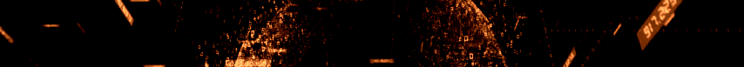

CISIA
CENTER FOR ARTIFICIAL INTELLIGENCE SOLUTIONS
PRODUCE AND TRANSFER KNOWLEDGE BASED ON ARTIFICIAL INTELLIGENCE
Notes:
The CISIA mission is to produce and transfer knowledge based on artificial intelligence.
Make the AI arrive where it is really usefull.

Slide 6

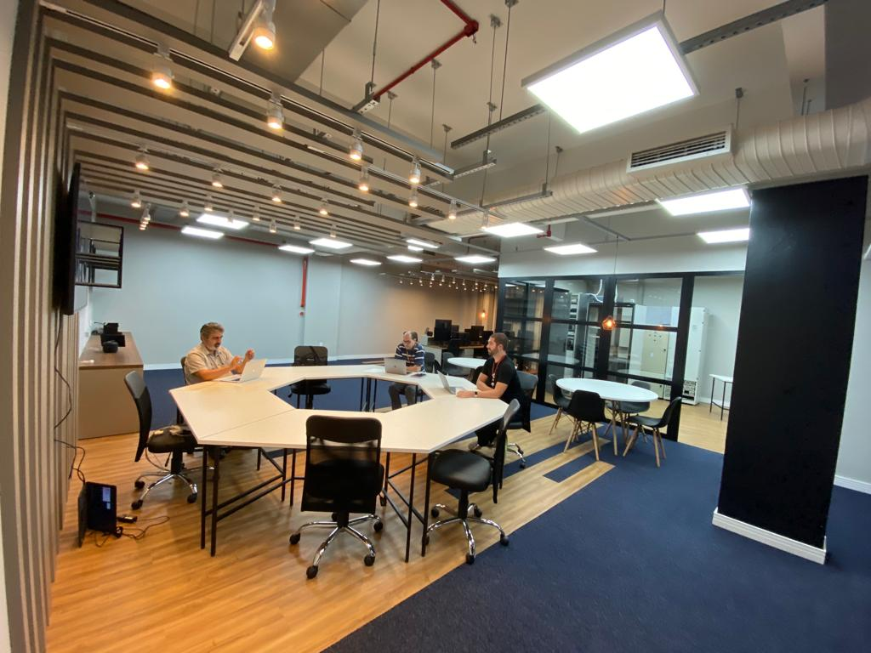
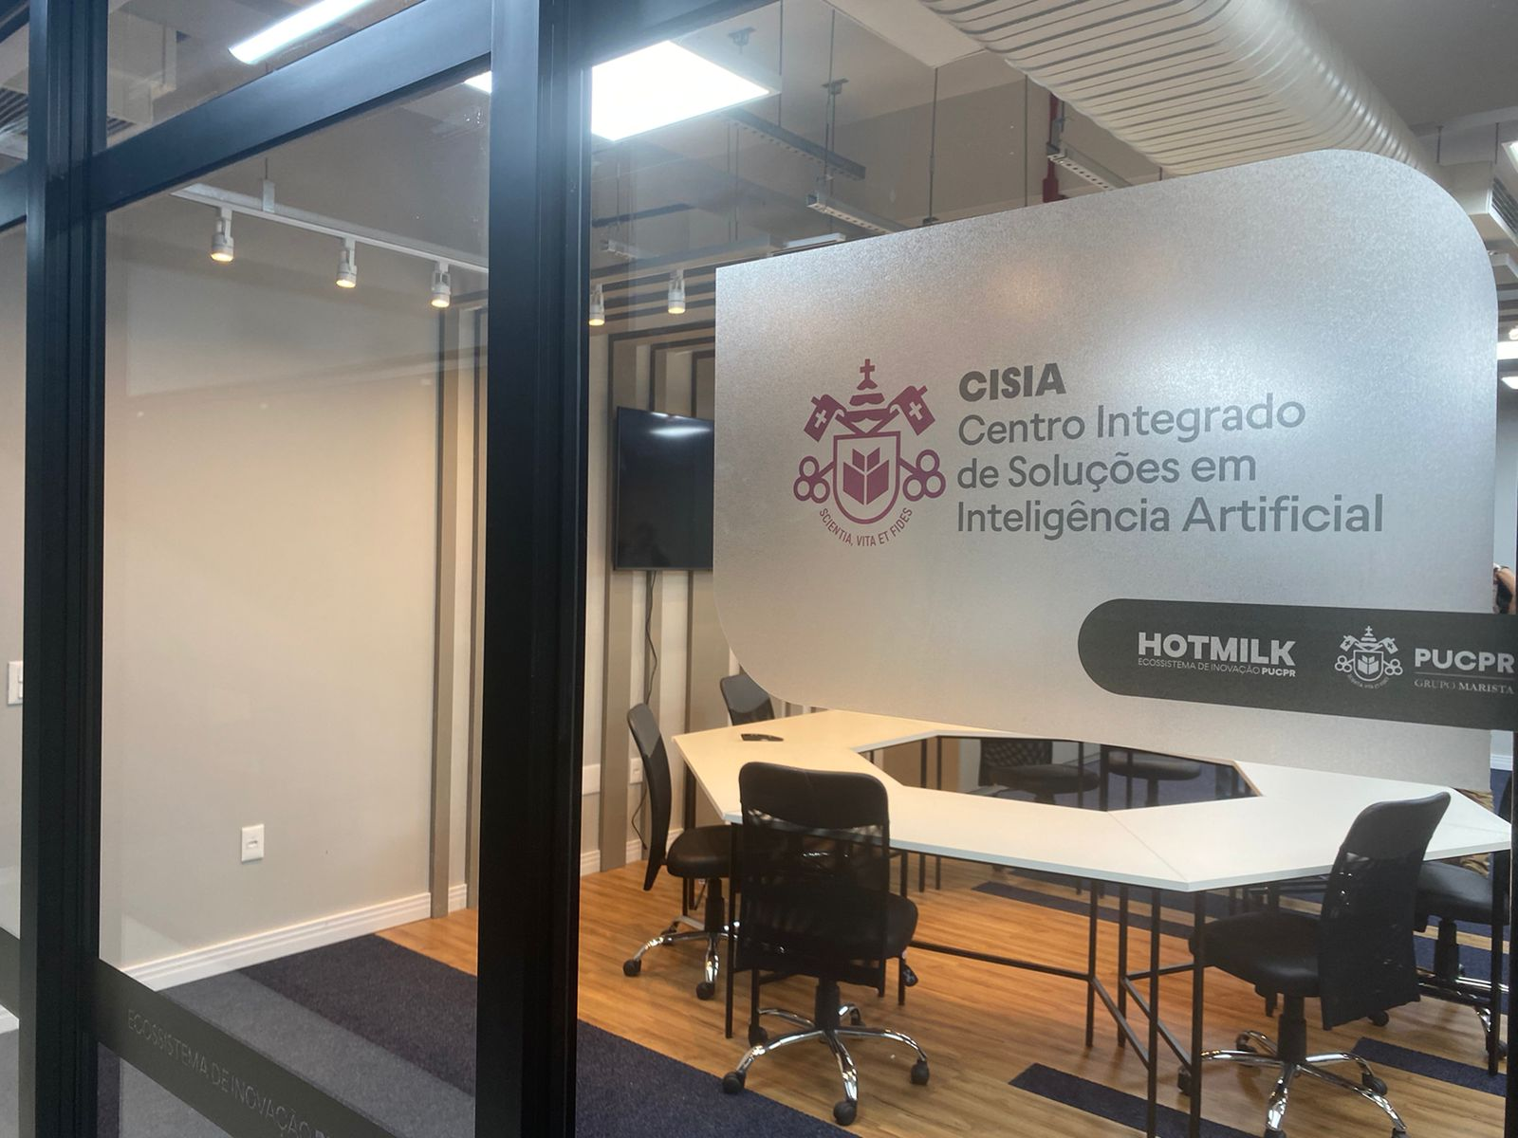
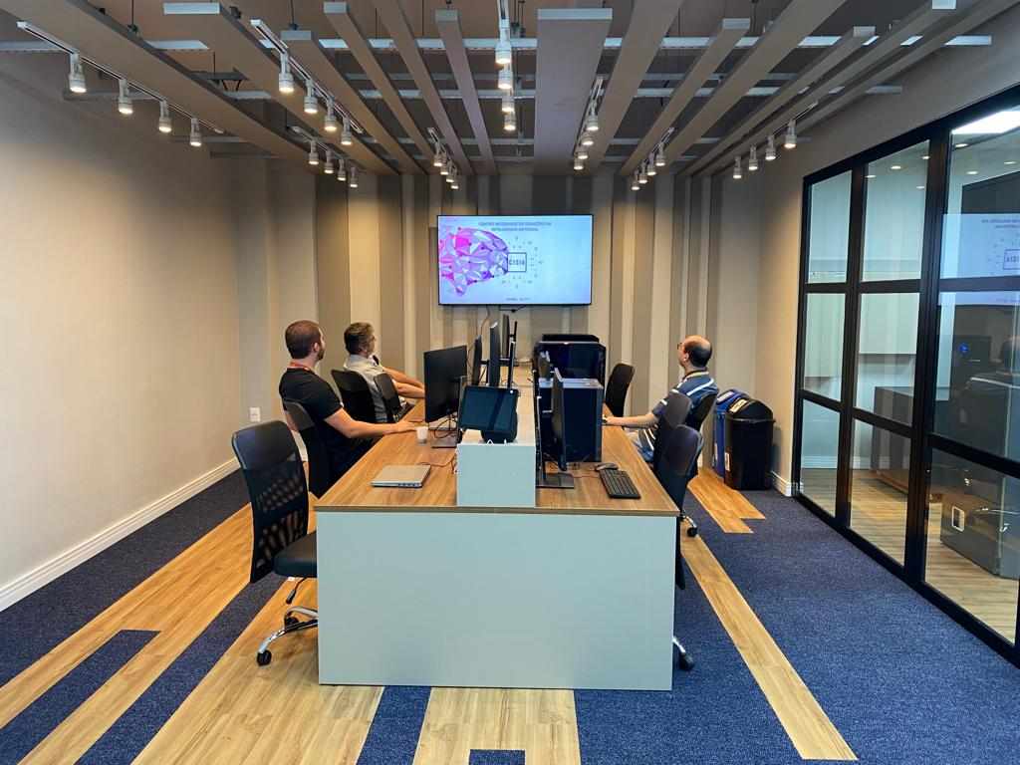



CENTER FOR ARTIFICIAL INTELLIGENCE SOLUTIONS
INFRASTRUCTURE
- 15+ researchers in various AI fields
- In total, 40+ researchers with projects related to the application of AI in various scenarios
- High-Performance Computer (HPC), 8 x NVIDIA H100 with 80GB each, 128 GB of RAM
- Data server Dell PowerEdge (data repository)

Slide 7

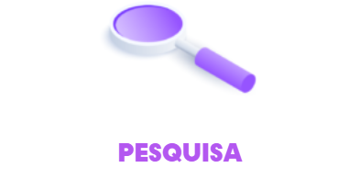
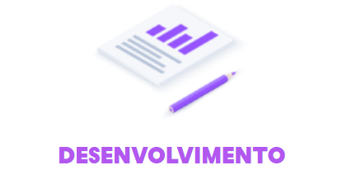



CENTER FOR ARTIFICIAL INTELLIGENCE SOLUTIONS
CISIA – Working Strategies
A
KNOWLEDGE
TRANSFER
RESEARCH
DEVELOPMENT
CONSULTING /
MENTORING
INNOVATION

Slide 8
CENTER FOR ARTIFICIAL INTELLIGENCE SOLUTIONS
Research Areas and Applications
Education
Health
Transport/Logistic
Data Science
Recommender Systems
Computer Vision
Temporal Series
Biometry
Machine Learning
Natural Language Processing
Smart Cities
Cybersecurity
Industry
Deep Learning
Big Data
Commerce
Government
Security

Slide 9





CASES

Slide 10
Real World Projects

Slide 11

Fábrica de Software Project
Since 2012, more than 400 graduate and undergraduate students applied:
  Computer Science, Computer Engineering and Information Systems.
Around 100 students/trainees:
  Students are evaluated every six months by the technical manager at Siemens and PUCPR.

Slide 12
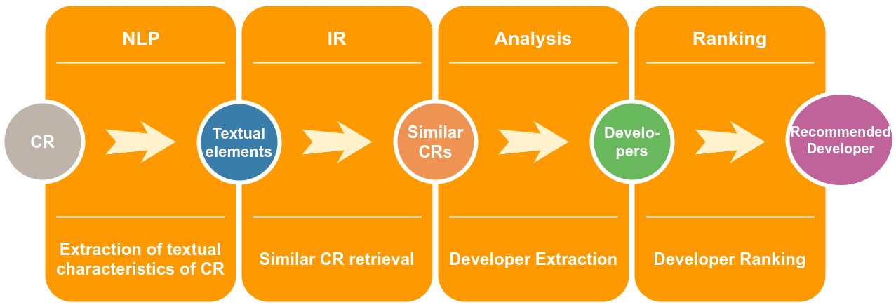
Developer Recommendation

Slide 13
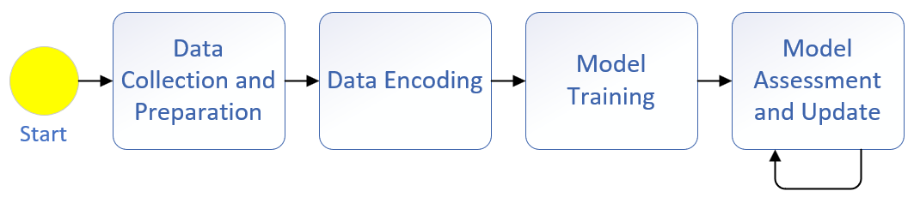
Test Recommendation Model
09

Slide 14
Motivation
Tests that find the most bugs are generally the most recommended or always selected.
Tests are usually performed after a specific bug has been fixed.
Need to select tests that ensure that the bug fix has not damaged another part of the software.
03

Slide 15


Hybrid Recommendation System
Test linked to Bug B2
Test linked to both Bugs
Similar Bugs
Similar Tests
B1
B2
Recommended Test for Bug B2
Test linked to Bug B1, recommended for Bug B2
06

Slide 16
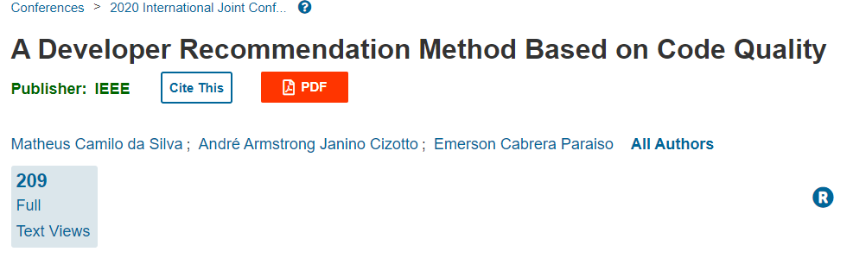
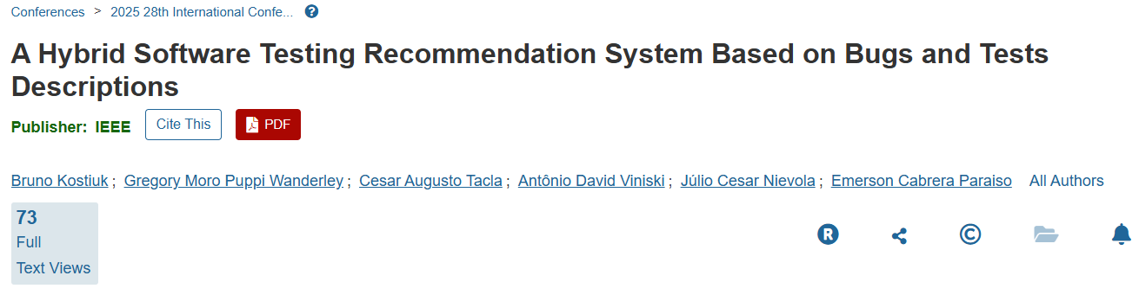
R&D Projects - Scientific Contribution

Slide 17


Information Retrieval
Information extraction from different types of documents.
Documents have different formats.
Some documents have thousands of pages.
Tools used:
  OCR
  Large Language Models

Slide 18

Predictive Learning Analytics
Recommender system to improve student learning.
Predicts students’ final grades after two weeks of classes.
Machine learning + Data mining.

Slide 19
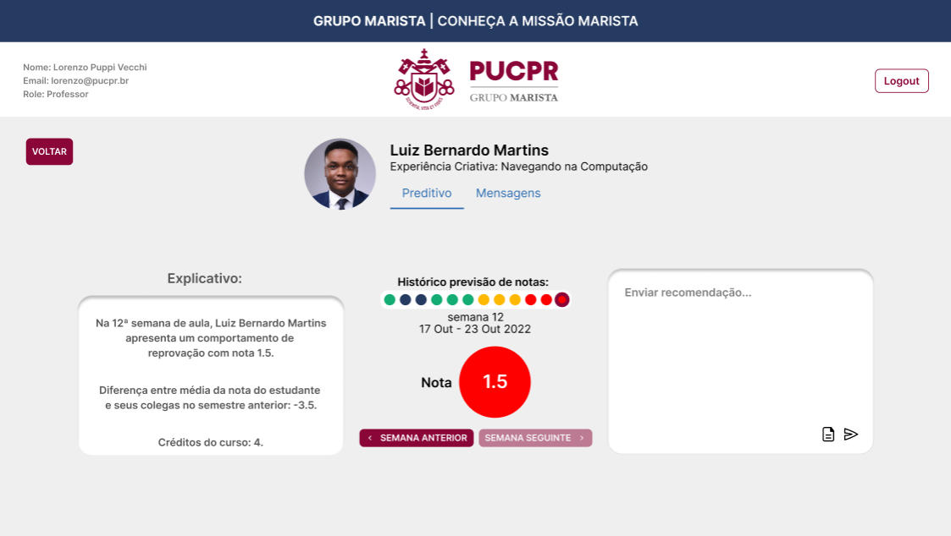
Descriptive
Predictive
Prescriptive

Slide 20
What did we learn?

Slide 21
Lessons Learned
Many requests are not related to AI.
Main AI techniques used:
  Machine learning:
    Deep Learning, Classifiers, regressors for structured data.
    LLMs for unstructured data (text).
  Tailored solutions:
    Every single application may lead to different approaches.

Slide 22
Lessons Learned (contd.)
Real data manipulation:
  Low quality, bias, etc.
  Is there enough data to train the models?
  In-house X third-party systems.
  Privacy, compliance, and security issues.
AI is not deterministic. Results are not always “perfect.”

Slide 23
Lessons Learned (contd.)
AI projects have several steps:
  The first results may take some time to appear.
Industry-side team:
  Need to build/reinforce a data science team!
Funding.

Slide 24




CISIA
CENTER FOR ARTIFICIAL INTELLIGENCE SOLUTIONS
Please, contact:
Visit our website
paraiso@ppgia.pucpr.br

