Slide 1


From Frustrating Calls to Instant Results

Slide 2
Just like Nubank wasn't just another credit card, DigAÍ isn’t another AI chatbot.
It's building the foundational infra
for AI agent success in Brazil and will become "the AWS of AI Agents".
ACTUAL PICTURE FROM THE DAY DIGAÍ WAS BORN FROM A DISCUSSION AMONG NUBANK SOFTWARE ENGINEERS (CO-FOUNDERS) AND NUBANK CHIEF SECURITY OFFICER (1ST ANGEL INVESTOR).

Slide 3






Meet DigAÍ (diga aí or "Tell Me Now" in portuguese).
It lives where AI meets the people - where true value generation is.
Business Application Layer
Business Agnostic AI Infrastructure
Third-party AI Apps & Integrations
HR
AI
Agents
Agent Tasks
Convers-ation History
Client
Debt Collections
CX
Data Insights
Payments
Voice
Business Need
DigAÍ is an uncoupled and flexible AI infrastructure that scales vertically and
deploys voice-based agents with minimal effort in any industry.

Slide 4
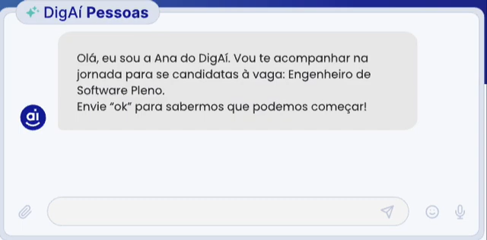
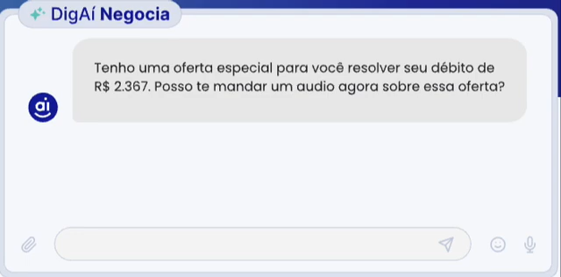
Where we're starting
DigAÍ's first agent was an AI interviewer and after strong signs of PMF it released an
AI debt negotiator.
It's Go-To-Market strategy relies on the fact that Enterprise AI adoption is driven by efficiency. Managers today need to show they can use AI to cut costs. If DigAÍ can quickly fulfill that need for different parts of an organization it will become that organization's go-to AI agent provider and gain insights into where skills and talent are allocated.
Notes:
Road to Success with check marks showing what has been accomplished

Slide 5
Step 1 Manager has a position to fill
Step 1 Manager has a position to fill
Step 2 HR scours CV database for ideal candidate
Step 2 HR scours CV database for ideal candidate
In HR, for instance, DigAÍ saves companies an average of 50 hours per hire, eliminating 4 steps in the hiring process.
Step 3 HR screens dozens of applicants over the phone
Step 3 HR screens dozens of applicants over the phone
Step 4 Top matches are interviewed by Manager
Step 4 Top matches are interviewed by Manager
Step 5 Manager provides feedback to HR and candidate
Step 5 Manager provides feedback to HR and candidate
Step 6 HR goes back to step 2 if no candidate found
Step 6 HR goes back to step 2 if no candidate found
Notes:
What we do via whatsapp or SMS and

Slide 6
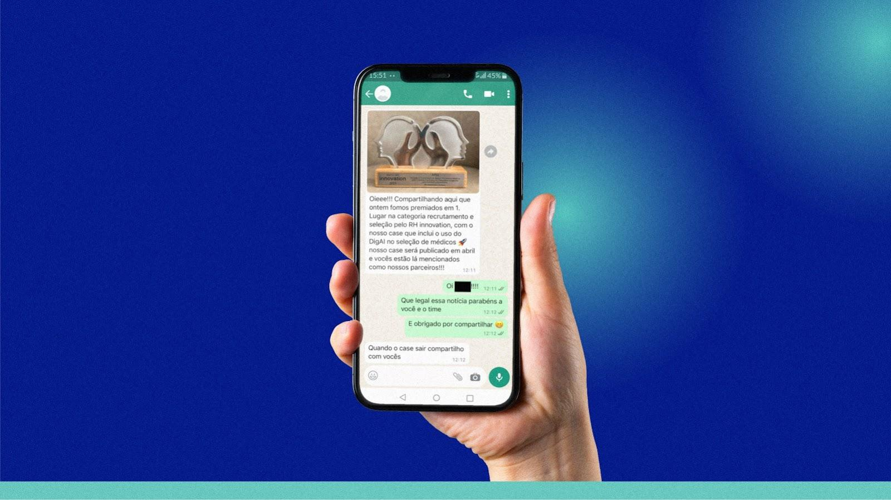
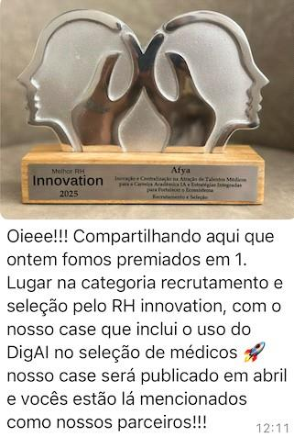

And its enterprise clients are winning Innovation Awards for using DigAÍ.

Slide 7

Step 1 Select customers from CRM
Step 1 Select customers from CRM
Step 2 Talk to each one individually
Step 2 Talk to each one individually
While in debt collections
DigAÍ has eliminated human workflows entirely, reaching settlements at 1/10th of the cost.
Step 3 Offer best deal as per available options
Step 3 Offer best deal as per available options
Step 4 Negotiate and close a deal with customer
Step 4 Negotiate and close a deal with customer
Step 5 Invoice and collect payment
Step 5 Invoice and collect payment
Step 6 Update CRM with new transaction
Step 6 Update CRM with new transaction
Notes:
What we do via whatsapp or SMS and

Slide 8

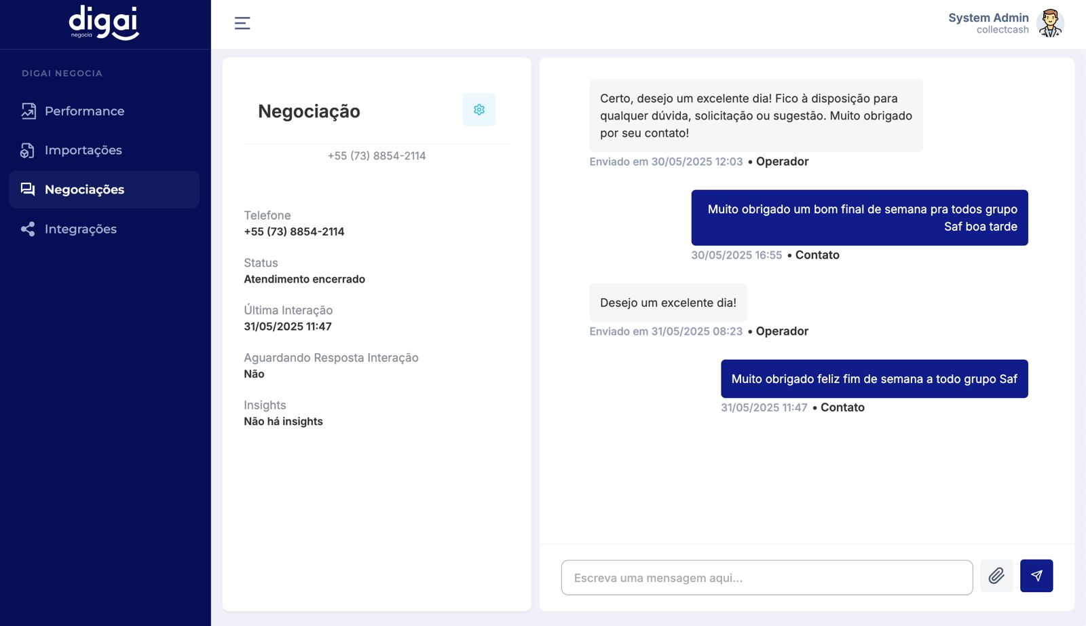
And debtors are thanking our AI for helping them clear their names.

Slide 9

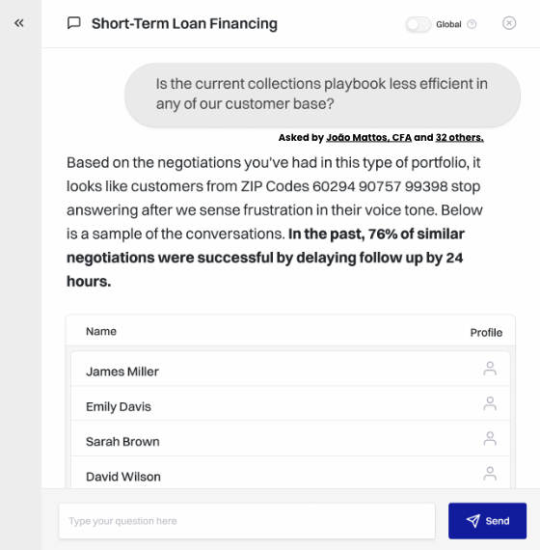
And finally, the more DigAÍ is used, the more it gains insights on how to optimize AI agent workflows.
Along with our strong technical team, this is our main source of defensibility in
Enterprise B2B.
Data
Insights
DigAÍ derives insights from conversational data to improve end-to-end processes and decision making.
Once DigAÍ starts being used, it's tough to switch.

Slide 10
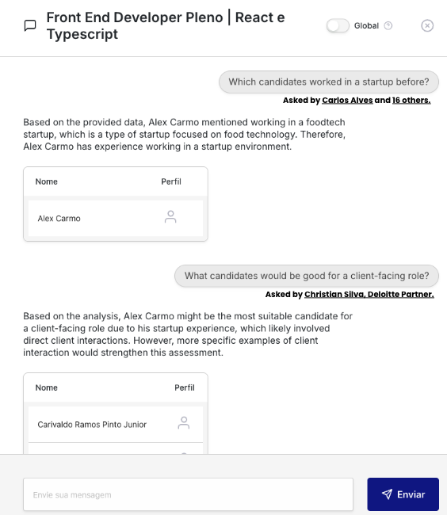
By deriving valuable insights from human-to-AI conversational data we prepare DigAÍ to reap benefits from strong network effects.
Imagine how quickly DigAÍ will spread once managers can exchange best practices on AI agent workflow management
Data
Insights
Through connection with social networks such as LinkedIn, users can find out what questions their peers are asking.

Slide 11

Get in
Touch
Christian Pedrosa, CEO
+1 707 701 3715
christian@digai.ai
https://www.digai.ai

