Slide 1

SS&C Blue Prism conduzindo o futuro de Agentic AI

Slide 2



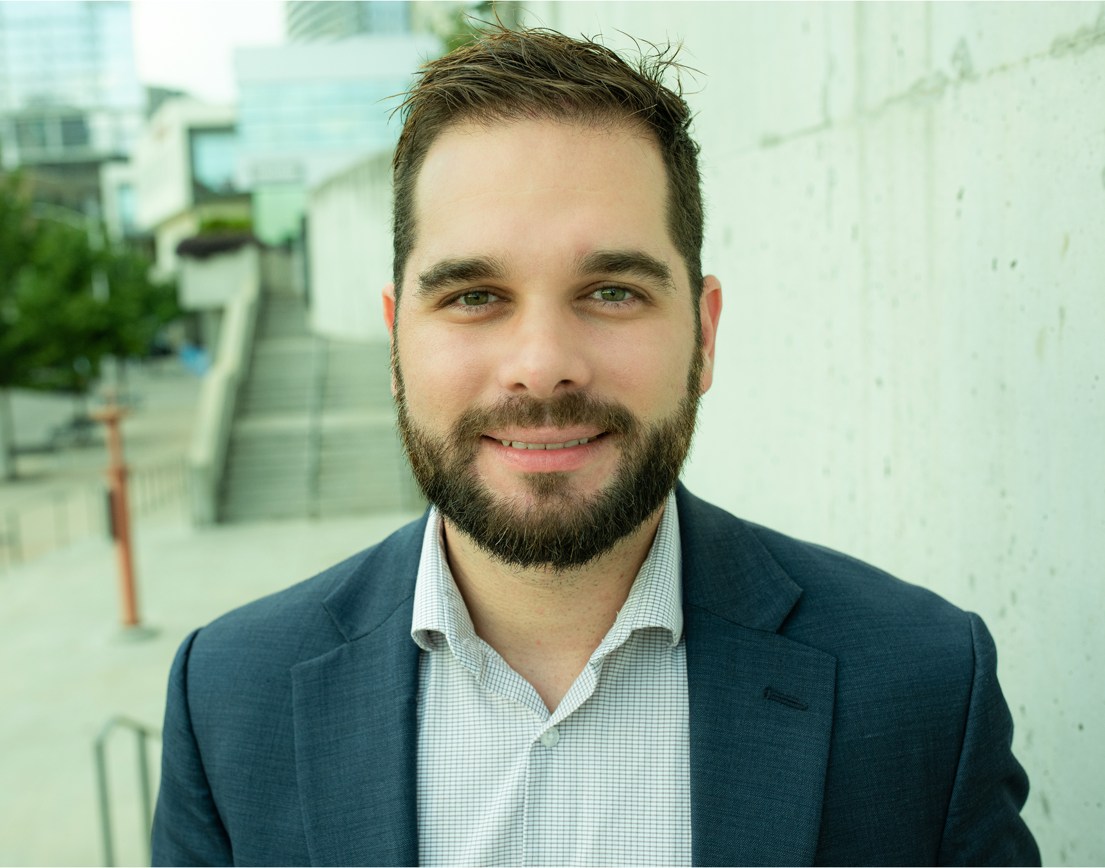

Bruno Beserra
Diretor Comercial – Brasil
Rodrigo Cid
Diretor de Alianças – Latam

Slide 3




SS&C | Blue Prism®
Brazil
Vinicius Gimenes
Rodrigo Cid
Sr. Solutions Consultant
Diretor de Alianças
Jonathan Aranha
Customer Success
Bruno Beserra
Diretor Comercial
Gustavo Vasconcelos
SDR
Notes:
Blue Prism Chorus is one of the most flexible and comprehensive business processing management platforms available featuring a robust feature set that includes:
Work orchestration. Improve collaboration and customer interactions through automated decision making and integration with other systems and applications, to orchestrate work across your entire organization.
Rules management. Define, deploy, execute, monitor and maintain a defined set of rules – including policies, requirements and conditional statements – to control or influence decisions across a specific process or your entire business.
Multi-experience communication. Create and deliver relevant messages to any customer as part of an automated or manual process from a centralized repository that’s maintained with the most up-to-date content to ensure customers receive the right personalized correspondence every time.
Content management. Capture, extract, and store data from multiple channels, such as phone calls, e-forms, SMS, letters, scans, faxes, and emails, to initiate, supplement, or complete work at any time directly within your processes.
Role-based workspaces. Employ case management for greater visibility into the complete customer journey to deliver the right work to the right resource at the right time.
Operational analytics. Get real-time visibility into your organization’s work, people and digital workers for the information you need to strengthen performance and improve your customer experience.

Slide 4
SS&C Blue Prism

Slide 5
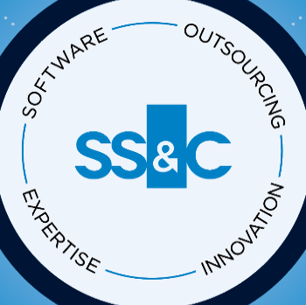
Valor na profundidade e amplitude da SS&C
Transaction Processing
Distribution
38+
Anos no mercado
$18.2 Bill
Market Cap
Accounting
Reporting
Industry Coverage
26,700
Colaboradores
$24.4 Billion
Valor de mercado
Operations
Asset Management
Compliance
Hedge Funds
Private Markets
20,000+
Clientes
100+
Produtos e Serviços
Trading
Banking
Insurance
Analytics
40
Países
$5.5 Billion+
em Receita Anual
Wealth
Healthcare
AUTOMATION
DATA
CLOUD
CONSULTING
People
Process
Technology
Alcance global, presença local
Profissionais certificados e licenciados: Ph.D., CPA, CFA, CA, PMP, CBCP, MBA, etc.
Alta posse, alta retenção
Projetar e implantar o modelo operacional de destino
Compreensão abrangente dos requisitos
Ciclo de feedback de desenvolvimento institucional
SOC 2, alto nível de controle
5.500 tecnólogos globais
As melhores soluções, plataforma integrada
Blue Prism e IA em todo o
Notes:
Option 2

Slide 6








The Financial & Healthcare Industries Rely on SS&C
40+
9
OUT OF
TOP 10
TOP 20
410
MILLION
CLAIMS PAID FY23
23
MILLION
COVERED LIVES
75
LARGEST
ASSET MANAGERS
of the
top 100
Fund
Administrators
Prime
Brokers¹
Hedge
Funds²
Distribution
Solutions³
Pharmacy
Total Health
$34+
TRILLION
financial transactions
46
MILLION
TA ACCOUNTS
$2
TRILLION
LEADING
SaaS
provider
Estimated
95%
99%
facilitated by
SS&C Intralinks
Asset Manager
Solutions
Regulatory
Filings
of all US
Commercial Paper
of all US
Municipal Bonds⁴
Retirement
Solutions
HF alert - https://www.hfalert.com/rankings/rankings.pl?Q=149
Hedge funds ranked by AUM
Based on U.S. mutual fund assets under management, according to Morningstar Direct March 2022
Derived from the annual issuance numbers published in The Red Book, which is the municipal industry listing of all municipal stats by firm, issuer, etc.

Slide 7
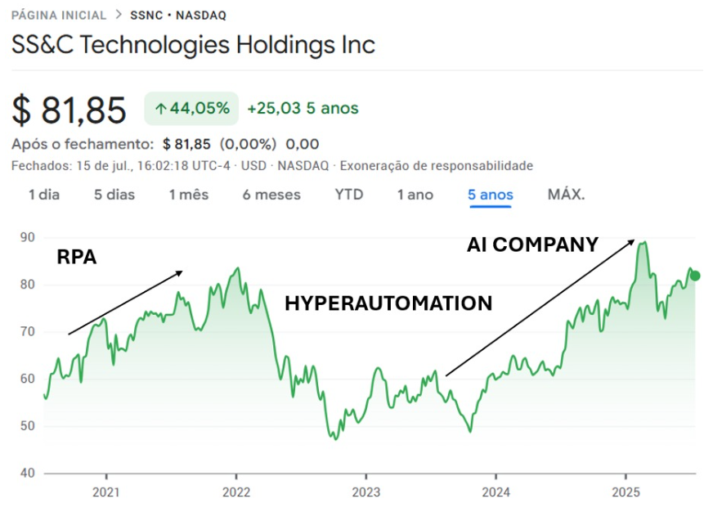

Slide 8
Case BUNGE

Slide 9

Bunge e a Jornada
BBS Gaspar
2025

Slide 10
Bunge no mundo

Slide 11
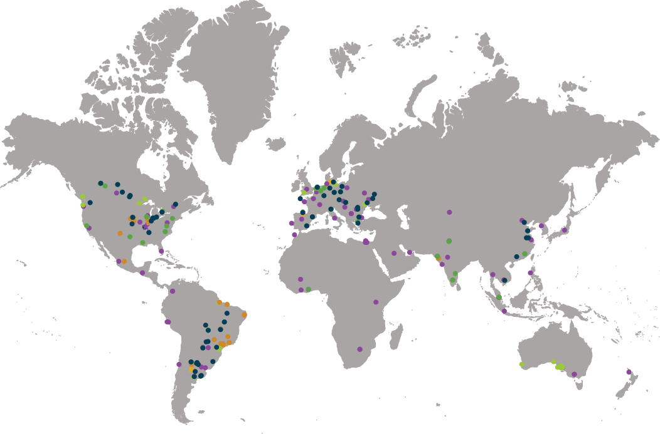






Presença global da Bunge
Os números estavam corretos no momento da criação deste documento, em julho de 2025, e podem estar sujeitos a alterações.
Plantas de processamento de oleaginosas
Refinarias e unidades de envase
Moinhos
Terminais portuários
Escritórios principais
Bunge é a número 1 do mundo em capacidade de volume de esmagamento
18
54
64
35
40
300
Moinhos
Refinarias
de óleos
Plantas de
processamento de oleaginosas
Unidades
de envase
Portos
e terminais
Unidades de armazenamento e silos
11
Notes:
Notas:
Temos a melhor plataforma global de oleaginosas do setor, uma equipe incrível e uma posição de liderança no mercado.
A nossa rede global está espalhada por seis continentes e inclui silos, unidades de processamento de oleaginosas e grãos e portos e terminais estrategicamente localizados.
Processamos soja e uma linha completa de oleaginosas: canola, colza e girassol, além de óleos tropicais, incluindo palma e karité. Esses óleos oferecem a matéria-prima para nossas refinarias e plantas de mistura e envase.
A partir de nossa sede localizada em St. Louis, Missouri, EUA, temos uma rede de ativos altamente integrada, que combina plantas de processamento de oleaginosas, unidades de moagem e de produção e envase de alimentos e ingredientes em todo o mundo. Oferecemos suporte a essas unidades com 30 portos e terminais, mais de 100 silos e mais de 200 navios fretados, o que proporciona à Bunge uma flexibilidade inigualável para poder se ajustar rapidamente às necessidades dos clientes e às condições de mercado em transformação.

Slide 12
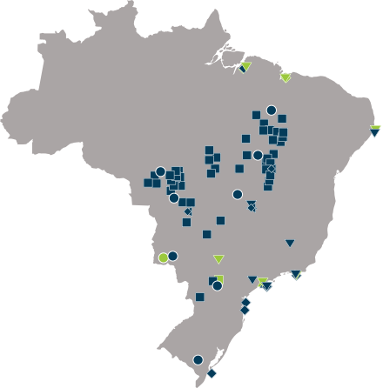





Presença da Bunge no Brasil
Presença em 18 estados
120 anos de atuação no país
Visão geral dos ativos combinados
Mais de 11.100 colaboradores
Bunge
Viterra
Plantas de processamento de oleaginosas
9
Refinarias de óleos
3
Unidades de envase
3
A Bunge é a número 1 do Brasil em originação de grãos e processamento de soja e trigo
Moinhos
12
Terminais portuários
10
Escritórios principais
3
Unidades de armazenamento e silos
50
Plantas de biodiesel
1
Os números estavam corretos no momento da criação deste documento, em julho de 2025, e podem estar sujeitos a alterações.
12
09
02
40 mm
10
>50
Moinhos
Unidades de processamento, refino e envase de soja
Usinas de
cana-de-açúcar
De toneladas de grãos originados em 2024
Portos e
Terminais
Unidades de armazenamento e silos
Notes:
Observações do palestrante:
Temos a melhor plataforma global de sementes oleaginosas do mercado, uma equipe incrível e uma posição de liderança no mercado.
Nossa rede global de unidades se estende por seis continentes e inclui silos para armazenamento de grãos, plantas de processamento de sementes oleaginosas e terminais portuários estrategicamente localizados.
Processamos soja, toda a gama de óleos especiais: canola, colza, girassol e óleos tropicais, incluindo palma e karité. Esses óleos fornecem a matéria-prima para nossas refinarias de óleos comestíveis, instalações de mistura e envase.
Temos uma rede fortemente integrada de ativos que combinam plantas de processamento de sementes oleaginosas, instalações de armazenamento de grãos, produção de alimentos e ingredientes e unidades de envase em todo o mundo. Suportamos nossas unidades com 30 terminais portuários, mais de 100 silos de grãos e mais de 200 embarcações marítimas fretadas, proporcionando à Bunge uma flexibilidade inigualável para se ajustar rapidamente às necessidades dos clientes e às mudanças nas condições do mercado.

Slide 13
Nossa Jornada
13

Slide 14
Time Line - Automation
2017 - 2018
2019 - 2020
2021 - 2022
2023 - 2024
2025
59 Automations
Team Building;
Tool selection;
Team India;
Blue Prism Award (Top 6);
125 Automations
Infrastructure Improvement;
Implementation of New Tools;
POC Intelligent Automation
225 Automations
Hyper Automation;
Data Science;
Automation with OCR;
AI Initiatives;
Service-Now;
Automation Portal;
RPA Training;
390 Automations
Focus on Business;
Strengthening with Service-Now;
Globalization of Projects;
RPA Training
Focus on company strategy;
M&A integrations;
400 Automations
GEN IA initiatives;
Globalization of the RPA area;
M&A integrations;

Slide 15
Nossos Números
15

Slide 16
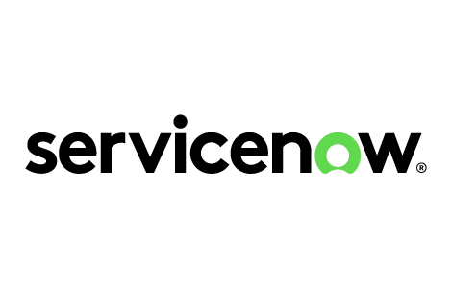





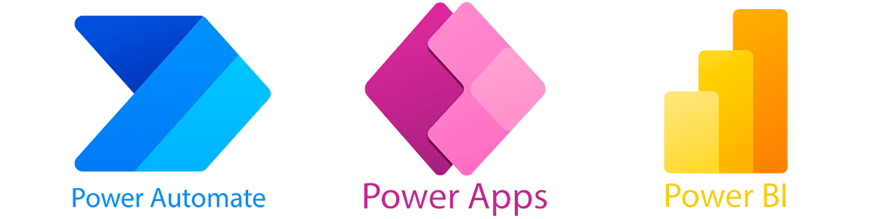
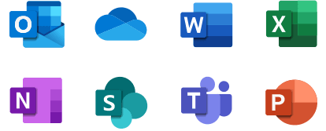


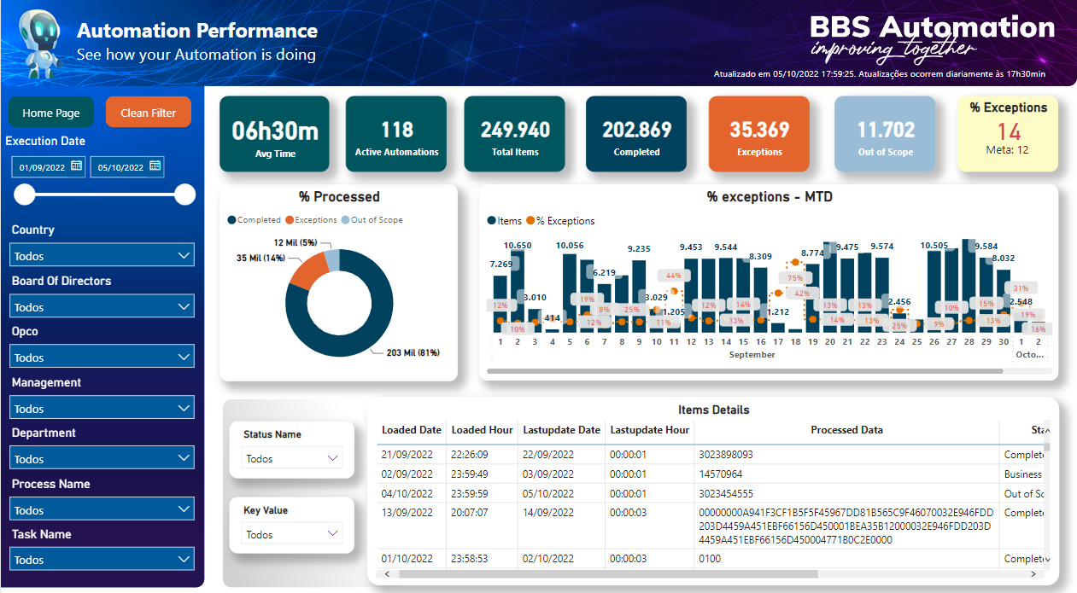
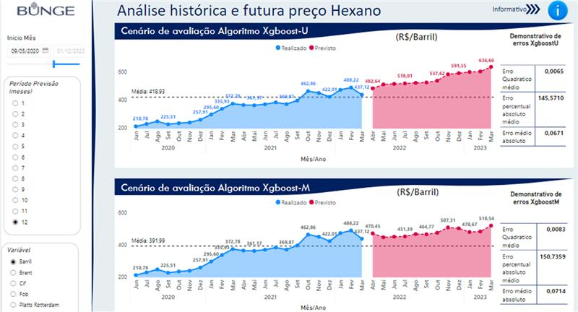

BBS
Automations
RPA and Automation
Automations in all processes, from quotation to payment
PTP
Automations from credit analysis to reconciliation
Tools
CTC
Key achievements
Automations for commercial portfolio management and delivery scheduling
CS
400 Process Automations Delivered
300 Running
1450 Tasks
Automations from tax calculation to tax payment
Automations to support export and import procedures, including document reading with OCR
TAX
GTE
Automations from accounting entries to closing
RTR
21K + Hours Productivity monthly
+ HR
+ Risk Position
+ FP&A
+ Controlling
+ Sales
+ Sustainability
Team structure
Team
DEV
1 Team Lead
7 Developers
Control Room
1 Team Lead
4 Developers
Flow control and weighing of trucks up to billing
130 FTEs Equivalent
Wheat
+ 6 Interns
260k+ Executions monthly
400k + Processed Items
Automations with Artificial Intelligence
Performance and Quality Dashboard
5,5% - Exceptions
1,5% - Terminated
NCM Classification
In 2024, 22% of BBS Tickets were attended by one of our bots
16

Slide 17
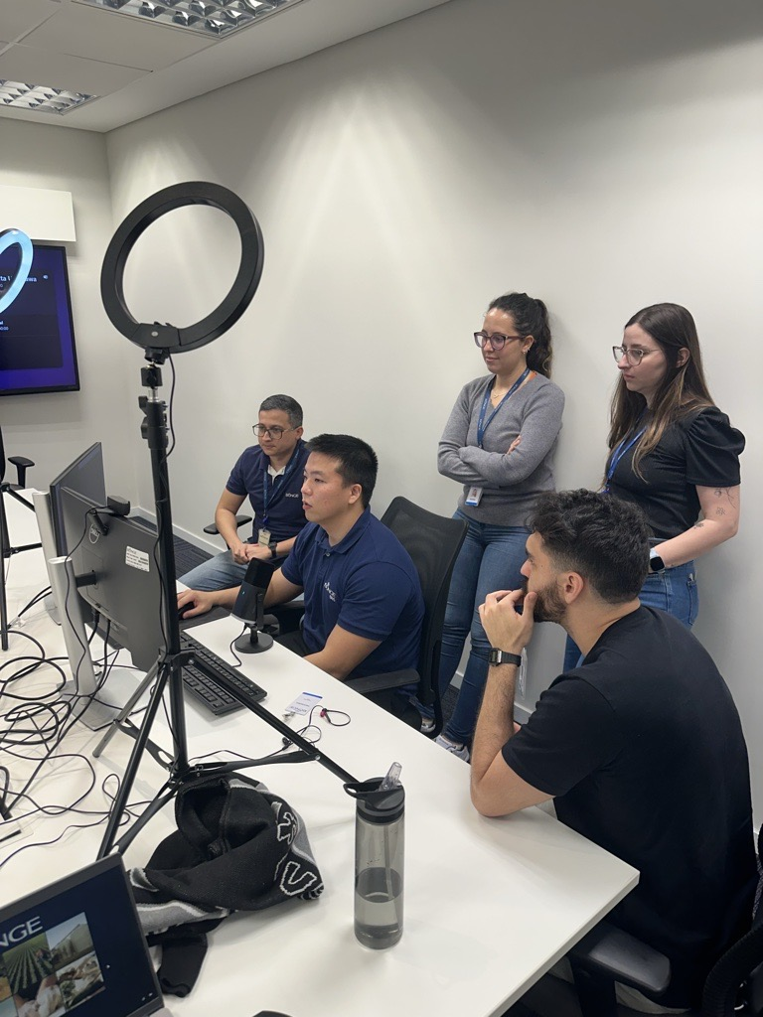
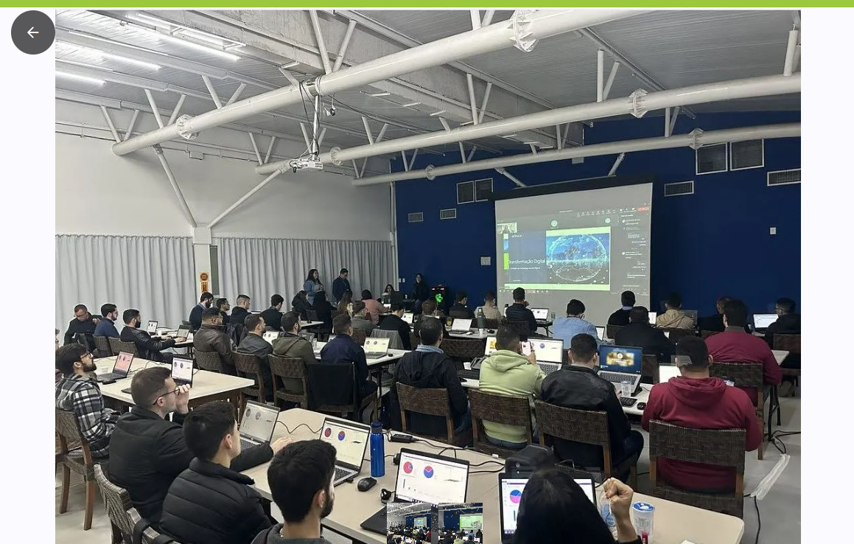
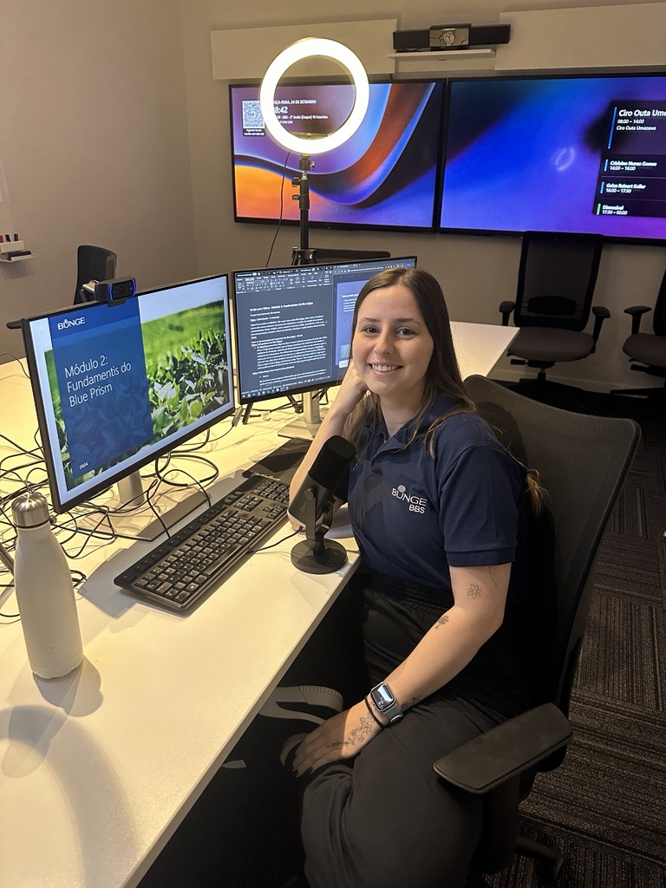
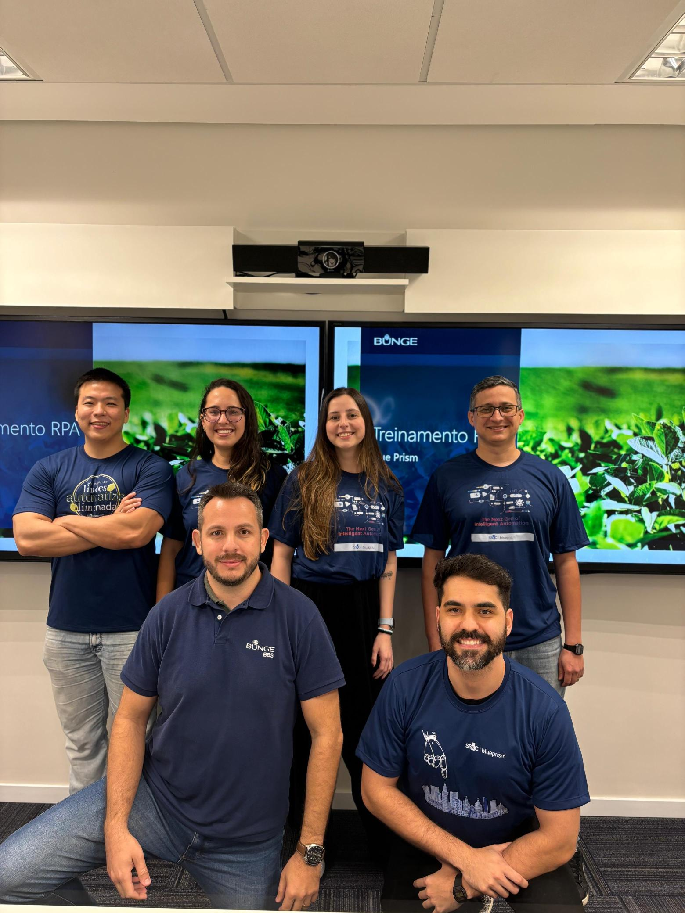
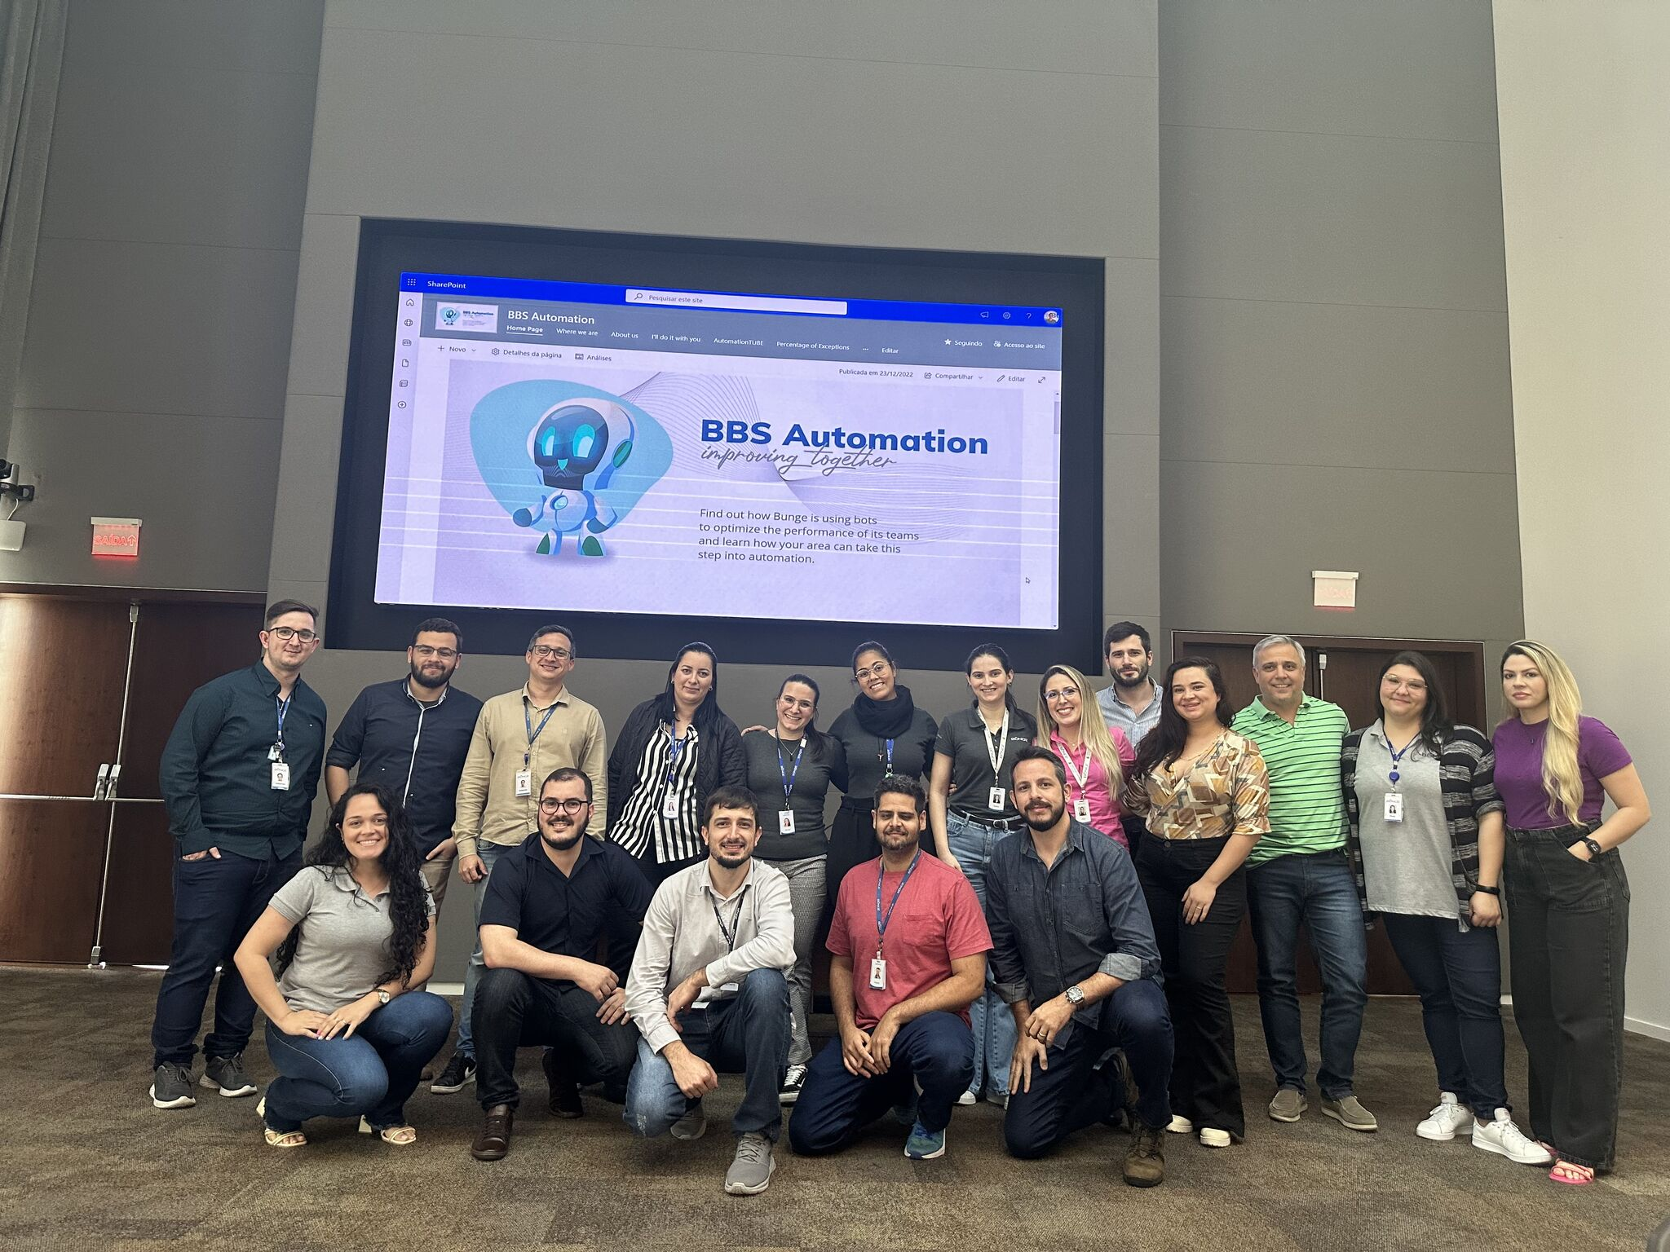

RPA Training
More than
90
People
trained
in Blue Prism
For 2025:
New
Blue Prism
Virtual Training

Slide 18
Blue Prism Chorus

Slide 19

SS&C | Blue Prism®
CHORUS
Work
Orchestration
Qual p próximo passo?
Operational
analytics
Rules
Management
KEY FEATURES
Case
Management
Omni-channel
Communication
Content
Management
Notes:
Blue Prism Chorus is one of the most flexible and comprehensive business processing management platforms available featuring a robust feature set that includes:
Work orchestration. Improve collaboration and customer interactions through automated decision making and integration with other systems and applications, to orchestrate work across your entire organization.
Rules management. Define, deploy, execute, monitor and maintain a defined set of rules – including policies, requirements and conditional statements – to control or influence decisions across a specific process or your entire business.
Multi-experience communication. Create and deliver relevant messages to any customer as part of an automated or manual process from a centralized repository that’s maintained with the most up-to-date content to ensure customers receive the right personalized correspondence every time.
Content management. Capture, extract, and store data from multiple channels, such as phone calls, e-forms, SMS, letters, scans, faxes, and emails, to initiate, supplement, or complete work at any time directly within your processes.
Role-based workspaces. Employ case management for greater visibility into the complete customer journey to deliver the right work to the right resource at the right time.
Operational analytics. Get real-time visibility into your organization’s work, people and digital workers for the information you need to strengthen performance and improve your customer experience.

Slide 20

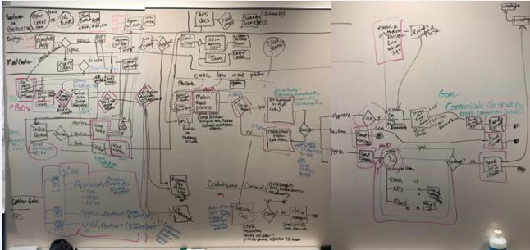
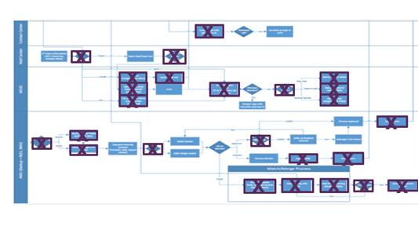
Blue Prism Chorus
Como funciona
Mapa do Processo Atual
Visão de Futuro Proposta com Chorus
Notes:
Image #1 (Left)
Process map illustrating the customer experience of applying for voluntary life insurance (employee benefits) that SS&C Blue Prism guided a client through in a 1-hour journey mapping session: Massive waste, 120+ day process, no visibility, no controls. The other vendors trying to get into this space think workflow is a 2 or 3 step process (think expense report approval. The photo below is the breath of a process that spans time and multiple actors.
Image #2 (Right)
Highlighted boxes (Purple) are process steps and items that go away on Day 1 implementation of Chorus. When including RPA in the integration, additional process steps/boxes are eliminated.
Benefits:
Systematic distribution of work
Labor focused on value-add activities
Full visibility of work in flight
Systematic management for performance guarantees
Configured procedures for U/W rules and special handle items
Shortened SLAs

Slide 21



Orquestração de processos (orquestração multiagente) hoje
Usando tecnologias determinísticas e não determinísticas
Agente de prompt
Agente da Qualidade
Pessoa
Agente de Comunicação com o Cliente
Cria prompt
Agente de documentos
Resolve problemas
Controla a Qualidade
Agente de e-mail
Pessoa
Fim do processo
Usando RPA
Human-in-the-Loop (if required)
Usando RPA
Cria caso
Extrai dados
Escreve Carta
Responde ao e-mail
Human-in-the-Loop
Usando o Gen AI
Usando o Gen AI
Usando RPA
Notes:
Multi-agent orchestration - we do this now!
In the past we’ve have a digital worker carrying out multistep tasks, making decisions using business rules and executing actions via APIs. And we’ve had people in the loop, carrying our checks, actioning exceptions and undertaking work that can’t be automated.
Chorus has orchestrated these work flows.
Now we've added AI as a processing option to make agents smarter. In the future, our agents will use more AI to operate partly independently – and starting to become agentic albeit in its infancy.
Orchestration provides
Manages inputs, outputs and data storage for each step
Appropriate management of any agent type
Exception handling
Performance monitoring across the process
Form build for human interfaces
No-/low-code process modeler to rapidly update the process
Automation provides
Task execution
Choice of agent type – an AI agent, a digital worker, an API – choose the right tool for the job
AI governance
Auditing
API library
Together they provide
Fully automated, AI-powered operations through Enterprise AI
A route from RPA and BPM to agentic process automation (APA)
An agile business transformation solution

Slide 22
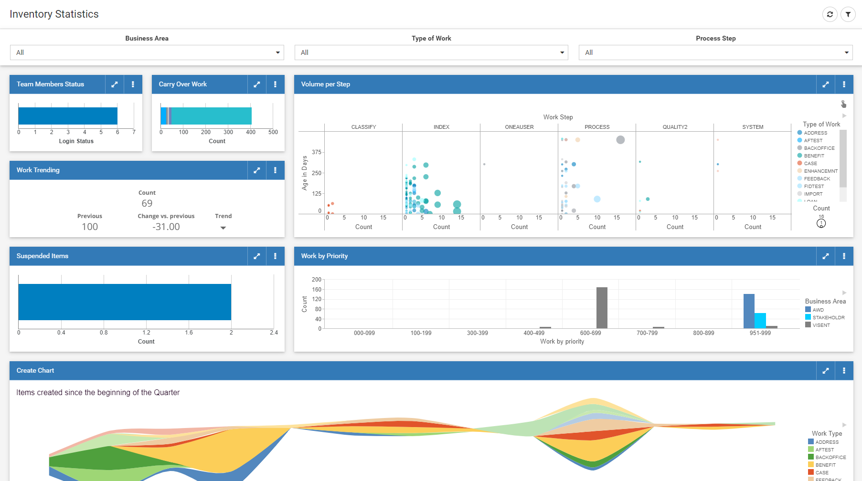
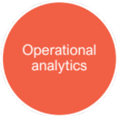
Principais Recursos e Benefícios
Chorus Operational Analytics
Faz com que os dados de desempenho de processos e força de trabalho sejam ainda mais acessível, envolvente e informativo para gerentes da linha de frente e líderes de negócios, para que possam gerenciar melhor suas operações em tempo real.
Com o Chorus Operational Analytics, você obtém insights oportunos:
Trabalhando no sistema
Aumentando a qualidade do trabalho realizado
Aumentando a produtividade e desempenho da força de trabalho humana e digital

Slide 23



Sem uma plataforma de governança de IA Com uma plataforma de governança de IA
Gatilho de processo
Gatilho de processo
Coleta de documentos
Preparando arquivos para uso do LLM
Execução de scripts
Coleta de documentos
Preparando arquivos para uso do LLM
Execução de scripts
Pre-Processing
Pre-Processing
AI Gateway
Inferência LLM
Processamento de IA/ML
Ferramentas
Classificação de documentos
Fragmentação RAG
Fluxos de trabalho agenciais
Redação/Stetting
Auditoria e explicabilidade
Risco de resposta e medidas de qualidade
Governança de IA
Monitoramento de qualidade
Regras de governança
Auditoria
AI Model
RISKS
Guardrails
Sem auditabilidade, explicabilidade
Sem controles de qualidade
Não está em conformidade com a Lei de IA da UE para muitos usos
Sem guarda-corpos embutidos
Inferência LLM
Processamento de IA/ML
Ferramentas
Modelos de IA (GPU)
Guardrails
Auditoria
Post-Processing
Preparar saída LLM
Atualizar sistemas principais
Post-Processing
Preparar saída LLM
Atualizar sistemas principais
Conclusão do processo
Conclusão do processo
Notes:
On the left, we have a conventional AI or large language model setup with minimal oversight. Data goes into the AI model with little more than basic pre-processing, and results come out to the business. The risks here are significant: there’s no auditing or explainability, no robust quality controls, and the system can easily fail compliance requirements—especially under regulations like the EU AI Act.
On the right, by contrast, we see the same process but governed by the SS&C Tarvos AI Gateway. Data passes through auditing and guardrails both before and after the AI model runs. Advanced features, such as redaction, document classification, and retrieval-augmented generation, ensure data remains secure while outputs are accurate, explainable, and auditable. By the time we reach post-processing and integrate results back into core systems, we’ve maintained compliance and enforced consistent governance. Essentially, we’re turning what would otherwise be a risky, black-box AI process into a transparent, auditable, and compliant solution.
[BW Timed at 1:03.83]

Slide 24













Blue Prism CHORUS
Cómo funciona
Processamento direto
Tratamento de exceções
Verificação de
qualidade
Comunicações com o cliente
Automação alimentada por IA
Sourcing certo com
Auto-Routing
Minimize erros com IA
Notifique os clientes automaticamente, instantaneamente
Extração de documentos ML
Revisão de ML de baixa confiança
ML Flagging
Mensagens personalizadas
Integrações
(API y RPA)
Reparação NIGO
Auto-Validation
Comunicações seguras
Previsões de IA
Roteamento contínuo em qualquer lugar
Right-Sourced
QC Routing
Preferências de canal
Notes:
To show how Chorus works, let’s discuss a use case of it in practice.
When you think through your processes, such as client onboarding or a request to change details on their account …
It starts with omni-channel intake, the ability to meet customers wherever they are, and to bring all those channels together into one place.
Then we’re going to employ straight-through processing as much as possible, using capabilities like ML Document Extraction, integrations to other internal or external systems using APIs and RPA, and AI predictions to automate cognitive processes in the onboarding process.
There will be exceptions to that, so we’re going to auto-route those exceptions efficiently using right-sourcing. This could include review of low-confidence machine learning predictions, which will automatically improve with each exception that’s handled, and Not-in-Good-Order (NIGO) repair. Moving your business on the path to a zero manual work environment.
You need to make sure that all this automation isn’t decreasing your accuracy, so you’ll want to use machine-learning based flagging for errors and employ auto-validation techniques. And right-sourcing applies here, too—you may outsource the quality checking as well to ML.
And finally, your customer communications need to again meet them where they are, through their preferred channel with branded, personalized, secure messages.
This is all wrapped with real-time reporting and analytical tools that enable you to continually improve adapt and delight your customer base.

Slide 25
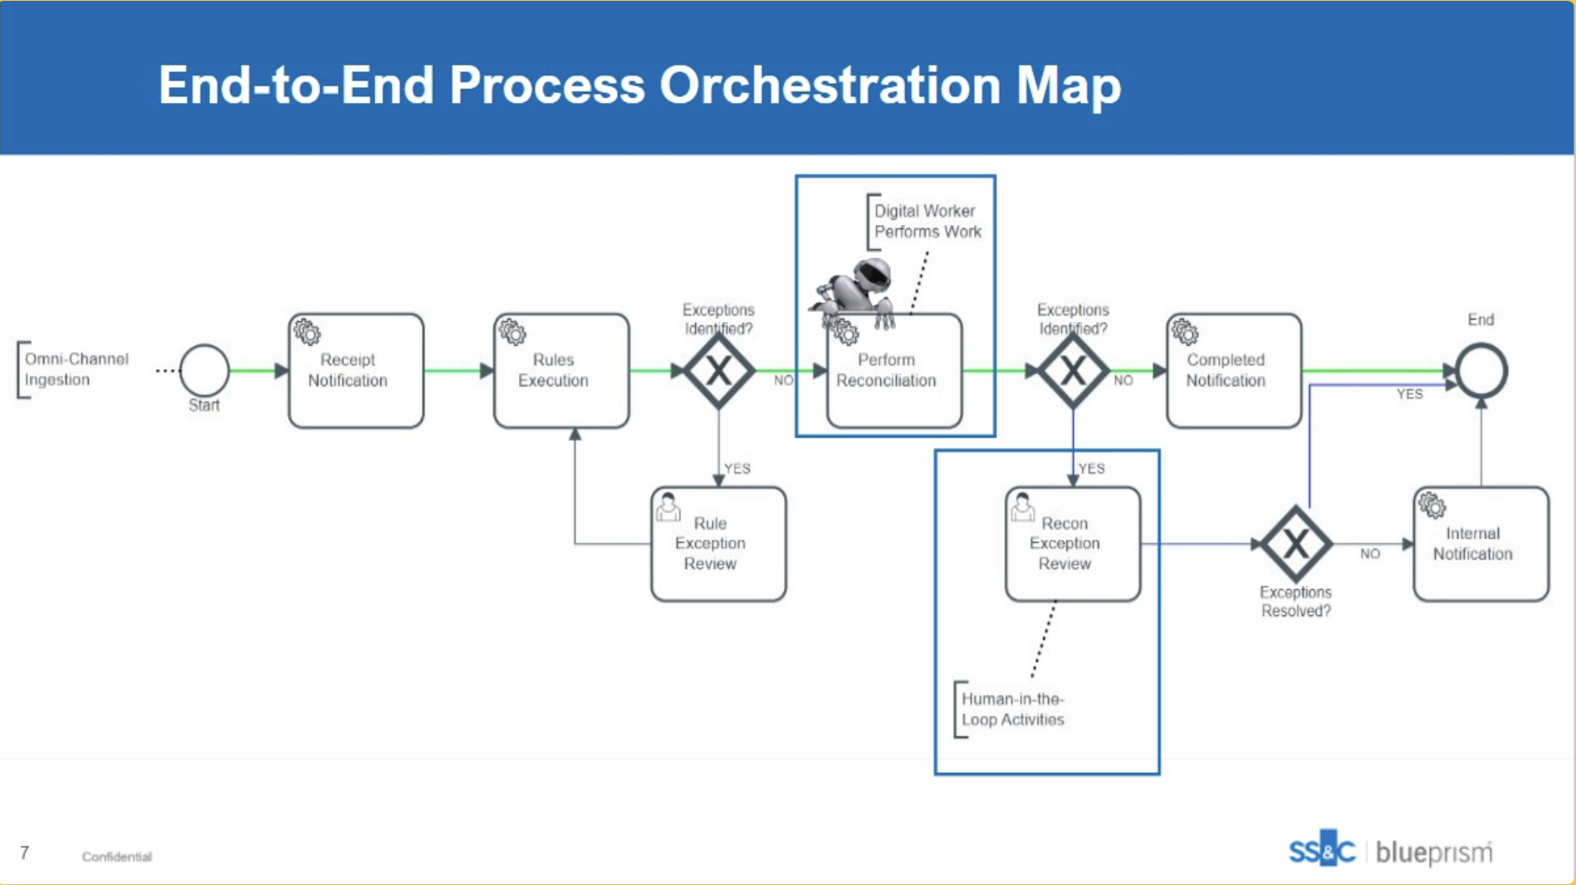

Slide 26


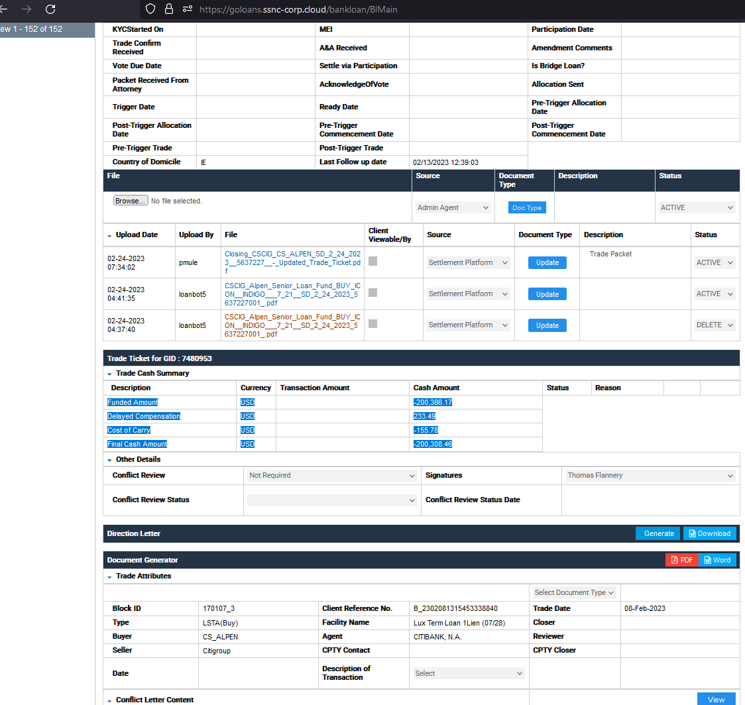
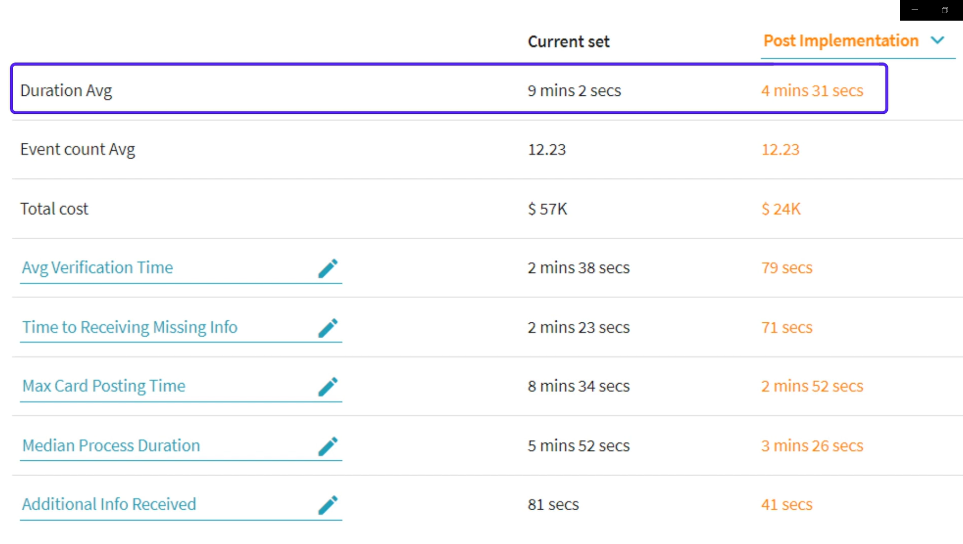


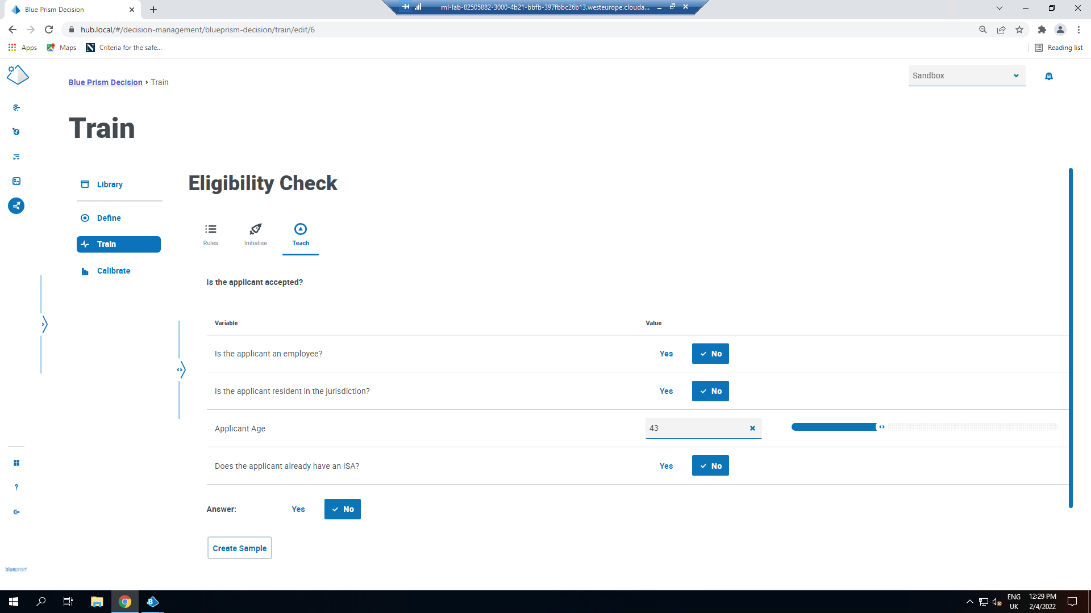
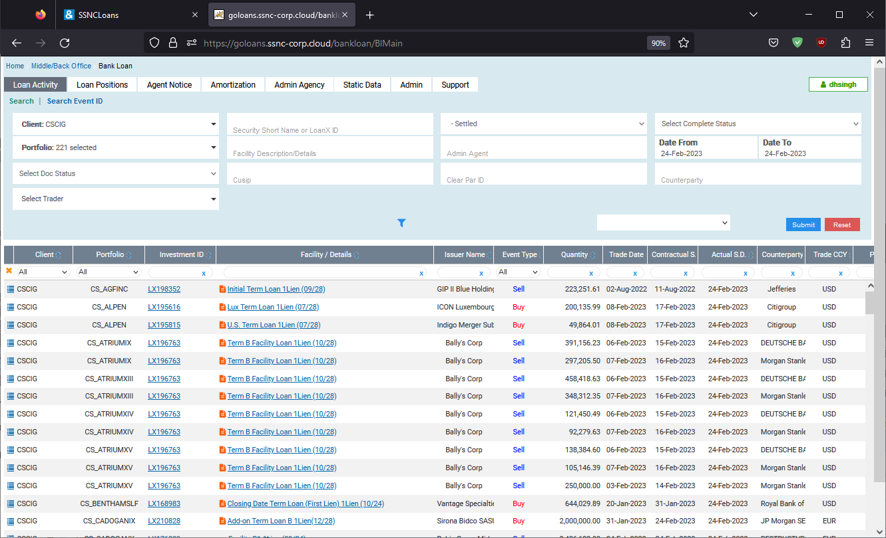
IA & Gen AI: Credit Agreement Processing
Status: In Production
“We need to ensure consistent credit data across our systems.”
Access Credit Agreements
Gen AI Extracts Key Details
Fetch GoCSM Mapping Files
Credit Manager
Digital worker downloads credit agreement documents from a shared drive and sends to Gen AI
Gen AI extracts the information security details based on the relevant prompt
Digital worker downloads GoCSM Mapping files which has all the respective security details
Validate Results
Update Master Documents
Reconciliation process is now all done automatically via SS&C Blue Prism and Gen AI
Credit Manager
Validate GoCSM mapping file with the GenAI credit agreement result
Digital worker sends corrected security details in new upload file to the original shared drive

Slide 27


Agradecimentos

Slide 29
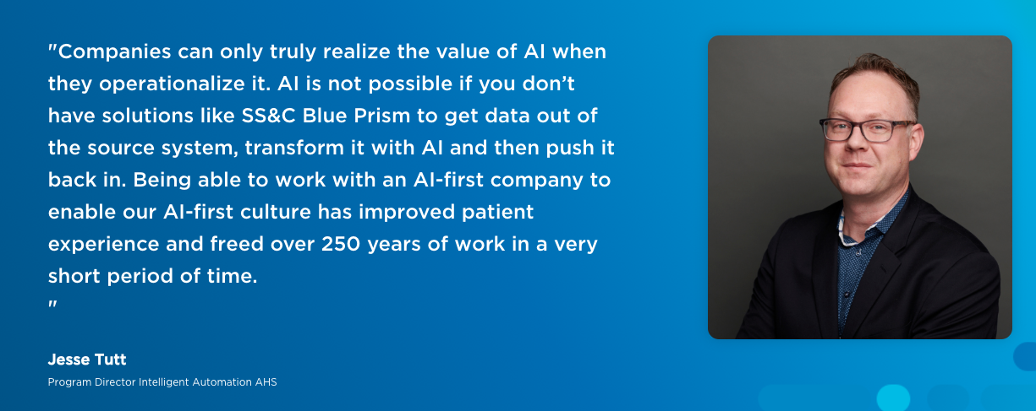


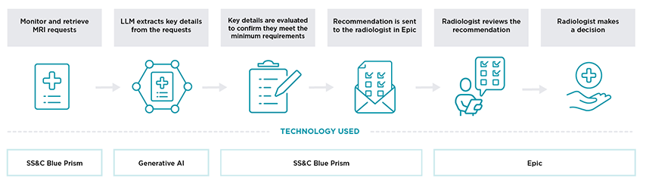
Cliente 1: Atendimento ao paciente na Alberta Health Services (AHS)
)
Notes:
Problema - O Alberta Health Services (AHS), o maior provedor de serviços de saúde do Canadá, enfrentava uma carga administrativa cada vez maior que desviava os recursos do atendimento ao paciente. Os processos manuais geravam ineficiências e aumentavam os custos operacionais.
Solução - A AHS implementou a automação de processos robóticos (RPA) combinada com a IA generativa para automatizar as principais tarefas administrativas e solicitações de ressonância magnética. Essa integração simplificou os fluxos de trabalho e reduziu a intervenção manual.
Benefícios - A automação resultou em uma economia de custos significativa de US$ 15,8 milhões. Ela aumentou a eficiência operacional, permitindo que os profissionais de saúde se concentrem mais no atendimento ao paciente. O sucesso desse programa posiciona a AHS como líder no aproveitamento da IA para melhorias na área da saúde.

Slide 30
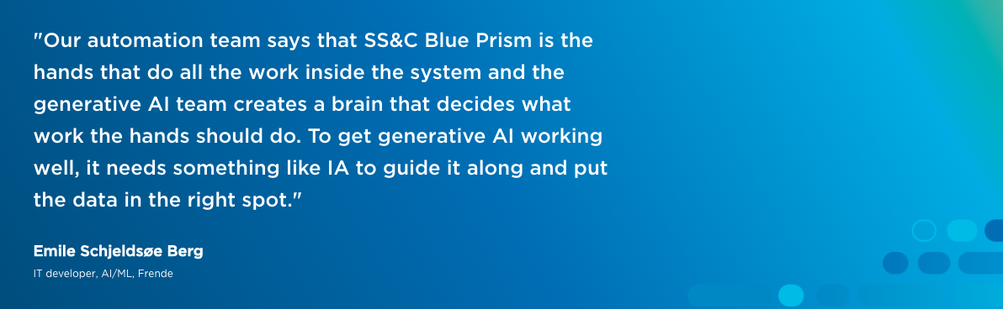






Cliente 2: triagem de e-mail na Frende Forsikring (EMEA)
Edifícios
Ler e-mail
Extrair conteúdo
Classificar
Encaminhar
Veículos
Jurídico
Modelo BERT ajustado com 99% de precisão
Animais de estimação/viagens/conteúdo
Trabalhadores digitais da SS&C Blue Prism
Notes:
Problema - A Frende, uma seguradora norueguesa, enfrentou um aumento no número de consultas de clientes, principalmente em relação ao processamento de sinistros. Seus métodos tradicionais não conseguiam acompanhar o ritmo, levando a atrasos e respostas inconsistentes.
Solução - Para resolver esse problema, a Frende implementou a automação inteligente usando a força de trabalho digital da SS&C Blue Prism. Essa integração simplificou o processo de consulta de sinistros, permitindo respostas mais rápidas e precisas.
Benefícios - Estamos mostrando um dos muitos casos de uso que eles abordaram - este, em particular, relacionado à triagem de e-mails.... Essa automação levou a melhorias significativas: maior satisfação do cliente devido aos tempos de resposta mais rápidos, redução dos custos operacionais e liberação da equipe para se concentrar em tarefas mais complexas. A adoção da automação orientada por IA pela Frende a posicionou como uma empresa com visão de futuro no setor de seguros.

Slide 31






Cliente 3: Consultas na Universidade de Sydney (APAC)
Sistema de gerenciamento de consultas
Ler consulta
Extrair conteúdo
Procurar resposta
Gerar resposta
Revisar a resposta e enviar
Agente treinado na base de conhecimento da universidade procura e cria uma resposta
Trabalhadores digitais da SS&C Blue Prism
Notes:
Problema - A Universidade de Sydney enfrentava milhares de consultas de alunos diariamente, desde a admissão até a formatura, em vários canais. A equipe dependia de bases de conhecimento fragmentadas, o que resultava em respostas inconsistentes e trabalhosas. As verificações de elegibilidade para a graduação eram especialmente complexas, consumindo milhares de horas devido à evolução dos requisitos dos cursos.
Solução - A universidade implantou agentes inteligentes para recuperar e responder automaticamente às consultas dos alunos. Para a graduação, os agentes analisam os guias de cursos históricos e os reconciliam com os cursos concluídos, usando fluxos de trabalho agênticos e revisão humana no circuito.
Benefícios - Isso simplificou as operações, melhorou a consistência, reduziu a carga de trabalho manual e estabeleceu as bases para dimensionar a automação e, ao mesmo tempo, reduzir o custo de atendimento e os erros humanos.
Discurso na BP Live Sydney - 22 de julho . ^{nd}
A equipe de atendimento ao cliente lida com milhares de consultas de alunos e possíveis alunos todos os dias, consultas essas que chegam por meio de vários canais
As perguntas podem variar de simples pontos de informação sobre como se inscrever para frequentar a universidade, pesquisas, solicitações de acomodação, critérios de entrada e assim por diante
A universidade tem muitas bases de conhecimento diferentes de conteúdo que a equipe teria de consultar para responder a essas perguntas
As respostas eram muitas vezes inconsistentes
A universidade criou um agente para pesquisar e responder automaticamente às perguntas
Hoje, a resposta é fornecida a uma pessoa para revisão, mas o AI Hub está monitorando quantas delas são alteradas pela equipe de atendimento ao cliente e que tipos de alterações estão sendo feitas para aprimorar o agente, pois a intenção é remover a etapa de revisão humana para quase todas as consultas.
Mais de 13.000 alunos se formam todos os anos na Universidade de Sydney
As solicitações de graduação são feitas pelos alunos
Um agente examina o livro de cursos do ano em que o aluno começou para determinar o caminho da graduação
Os cursos que o aluno fez são comparados com o guia,
Durante o tempo que o aluno leva para se formar, os nomes e as ofertas dos cursos podem mudar
Esses cursos precisam ser comparados com a trajetória para determinar se o aluno pode se formar e se há requisitos faltando
Esse é um processo complexo que exige milhares de horas de trabalho para ser executado
Os agentes agora são usados para procurar e reconciliar os requisitos do guia de cursos com os cursos realizados
O fluxo de trabalho agêntico e as pessoas no circuito são então usados para determinar se os alunos podem se formar.
Um dos problemas interessantes que a Universidade de Sydney teve que superar é determinar como evitar que os agentes discutam e aumentem o custo do serviço.

