Slide 1
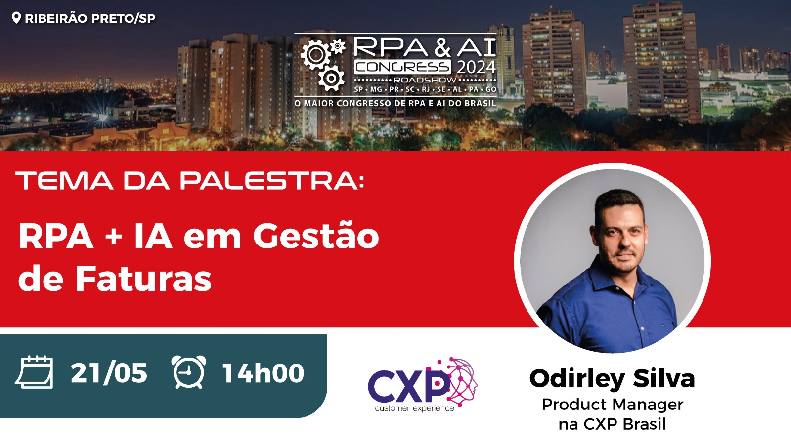

Slide 2

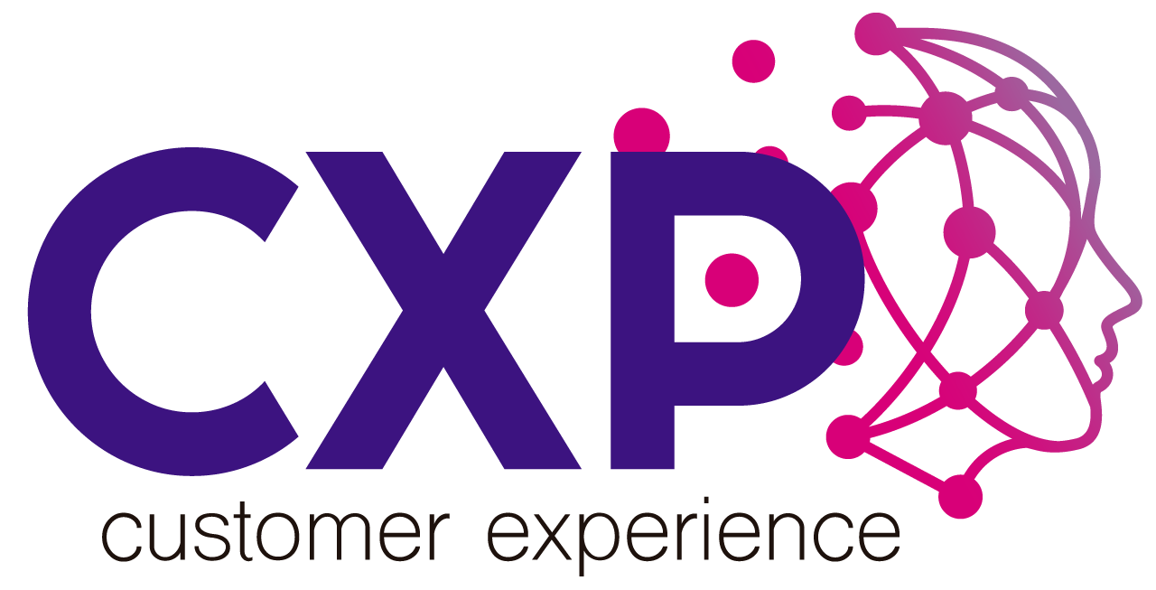
Apresentação
MEET BP IBM
Empresa CXP
Gestão de Faturas

Slide 3

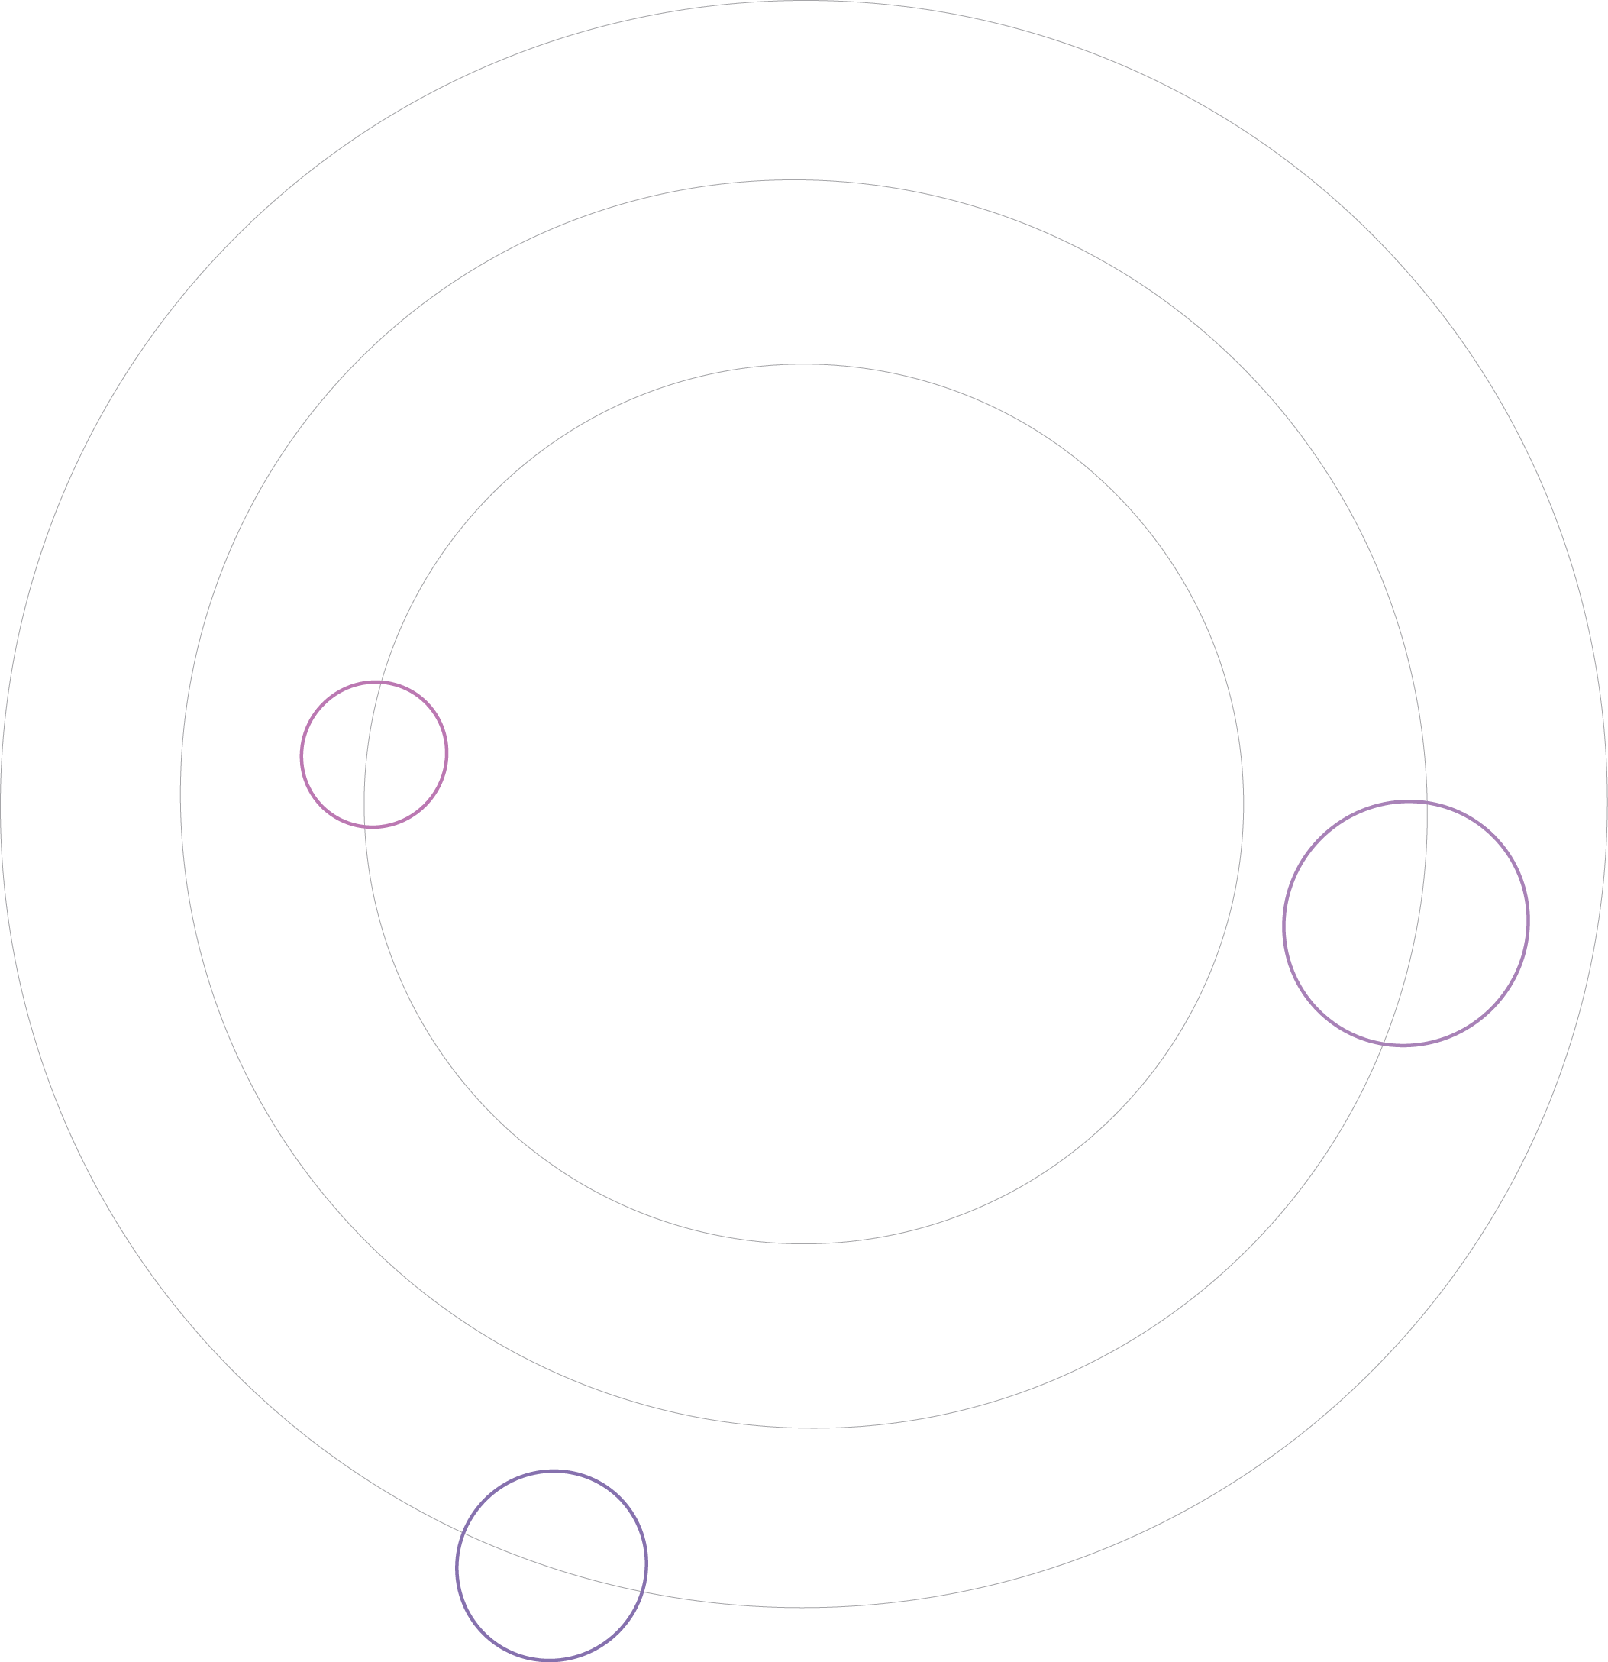




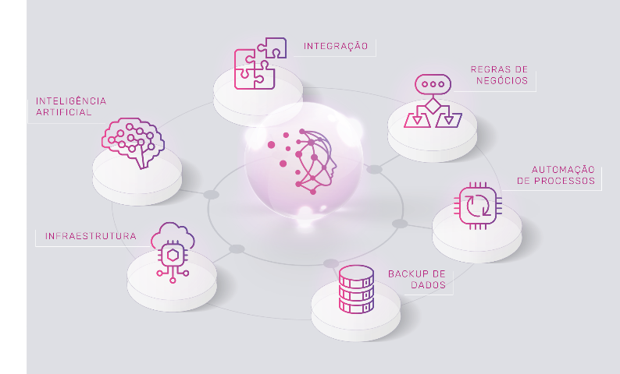



SOBRE A CXP
Somos especializados nos principais fabricantes do mercado
Especialistas nos principais produtos dos fabricantes acima:
Cloud
Automação
Integração
Devops
Aiops
Data Protection
Data & Ai

Slide 4
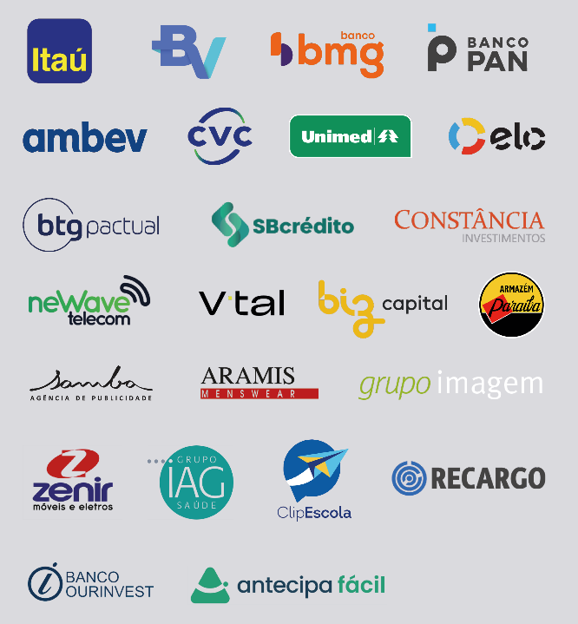


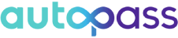
PRINCIPAIS CLIENTES

Slide 5




Características do Cliente
Alto número de espaço físico. O cliente possui mais de 4.000 prédios próprios.
Localização diversificada. Estes espaços físicos estão espalhados por todos os estados brasileiros.
Grande volumetria de documentos diversificados, inclusive faturas de energia, telefonia, água, etc.

Slide 6




Entendimento do Negócio
O gerencimento do pagamento das faturas de energia estavam distribuídas. Cada localidade se responsabilizava pelos seus pagamentos.
A diversidade de localidade também trazia um desafio, foram mapeados inicialmente mais de 115 Concessionárias diferentes.
Não existia uma centralização de gerenciamento destes cadastros, muito menos a possibilidade de acompanhar o fluxo de pagamento de cada unidade.
Parte destes espaços físicos são compartilhados com outras empresas, dificultando a gestão de consumo, pagamentos, multas, cortes, etc.

Slide 7
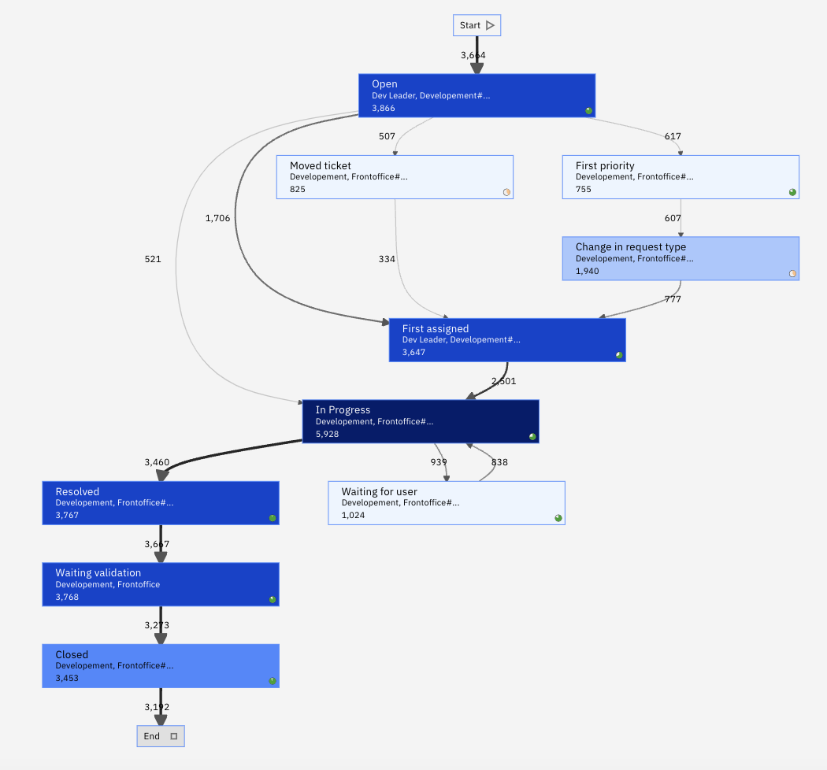
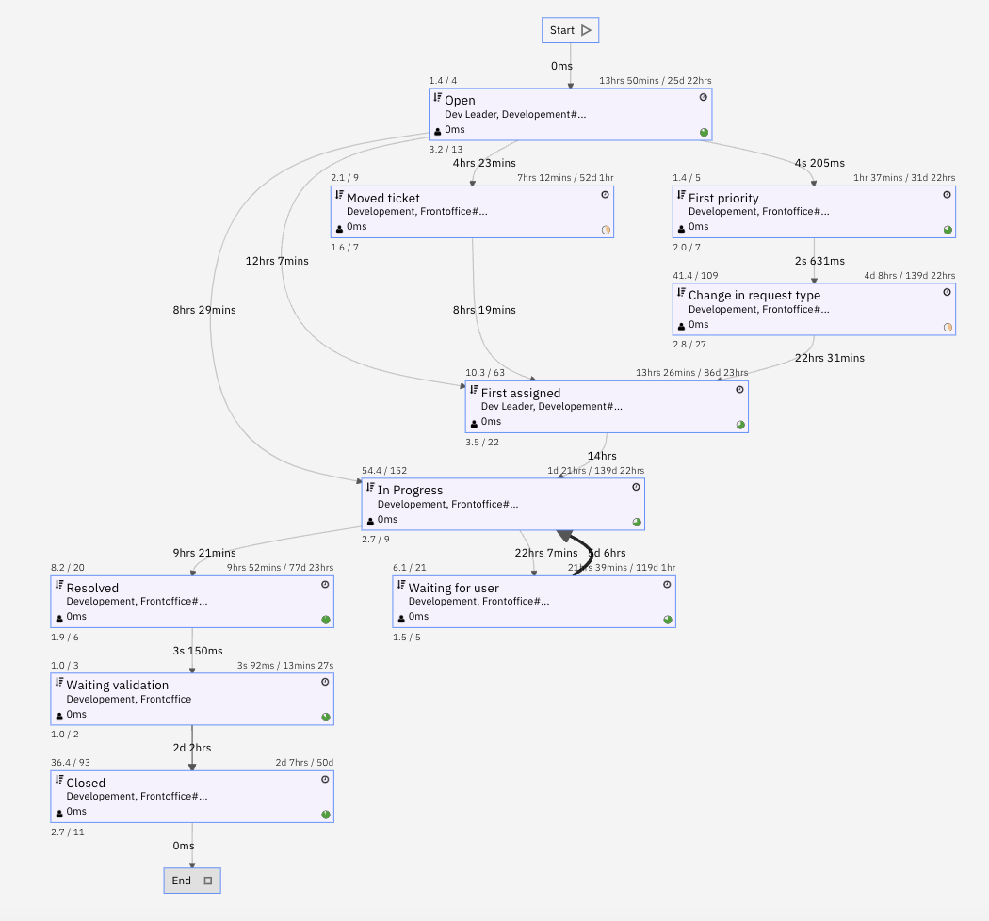
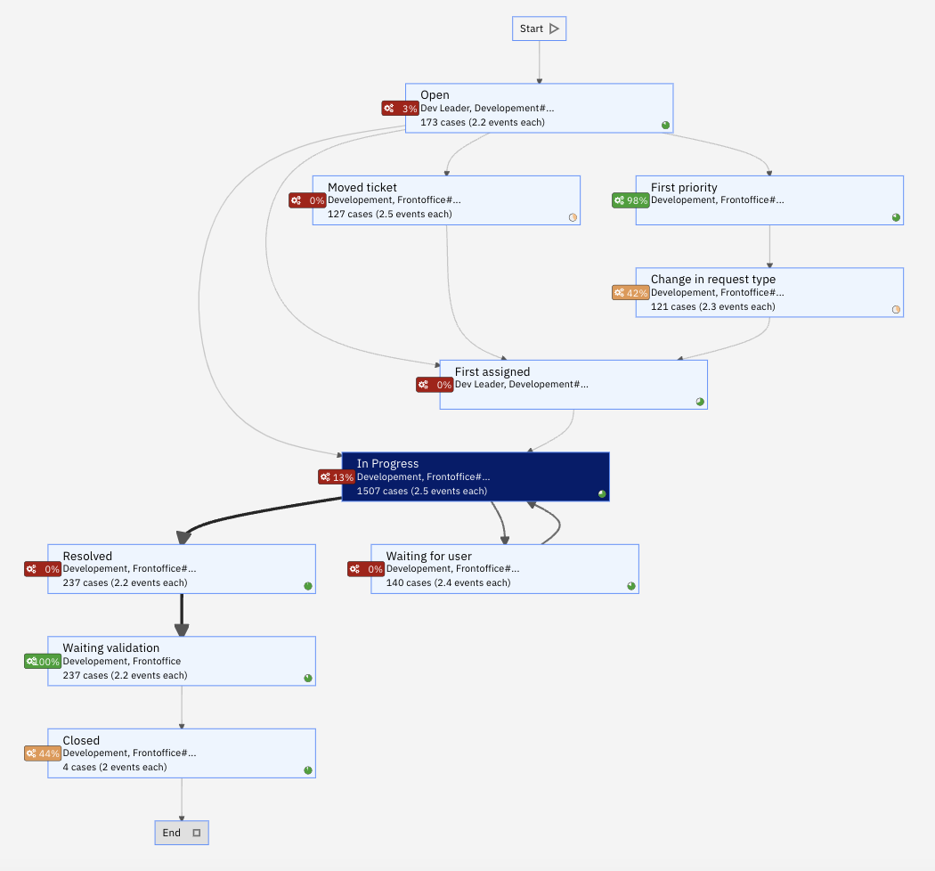
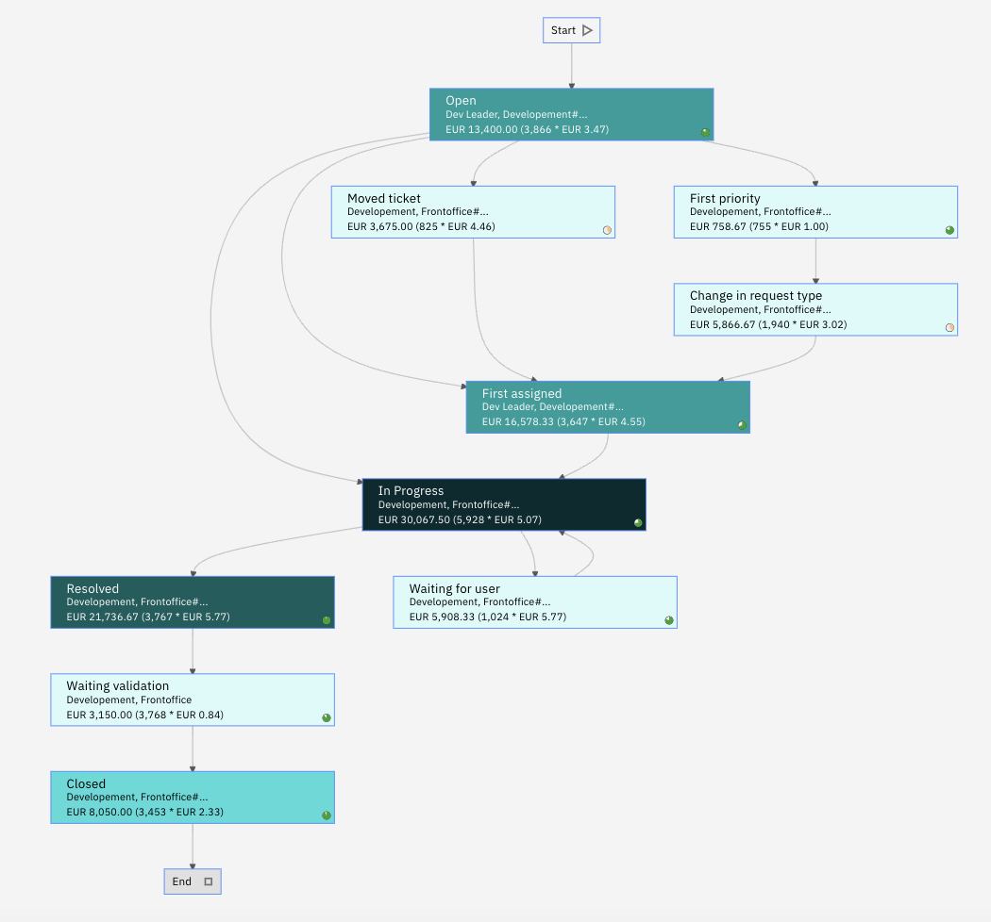
Process Discovery
Visualize o comportamento real do processo com base em dados
Atividades e transições mais frequentes
Duração de cada etapa do processo para identificar gargalos
Retrabalhos
Automação Existente
Custo de cada etapa do processo

Slide 8
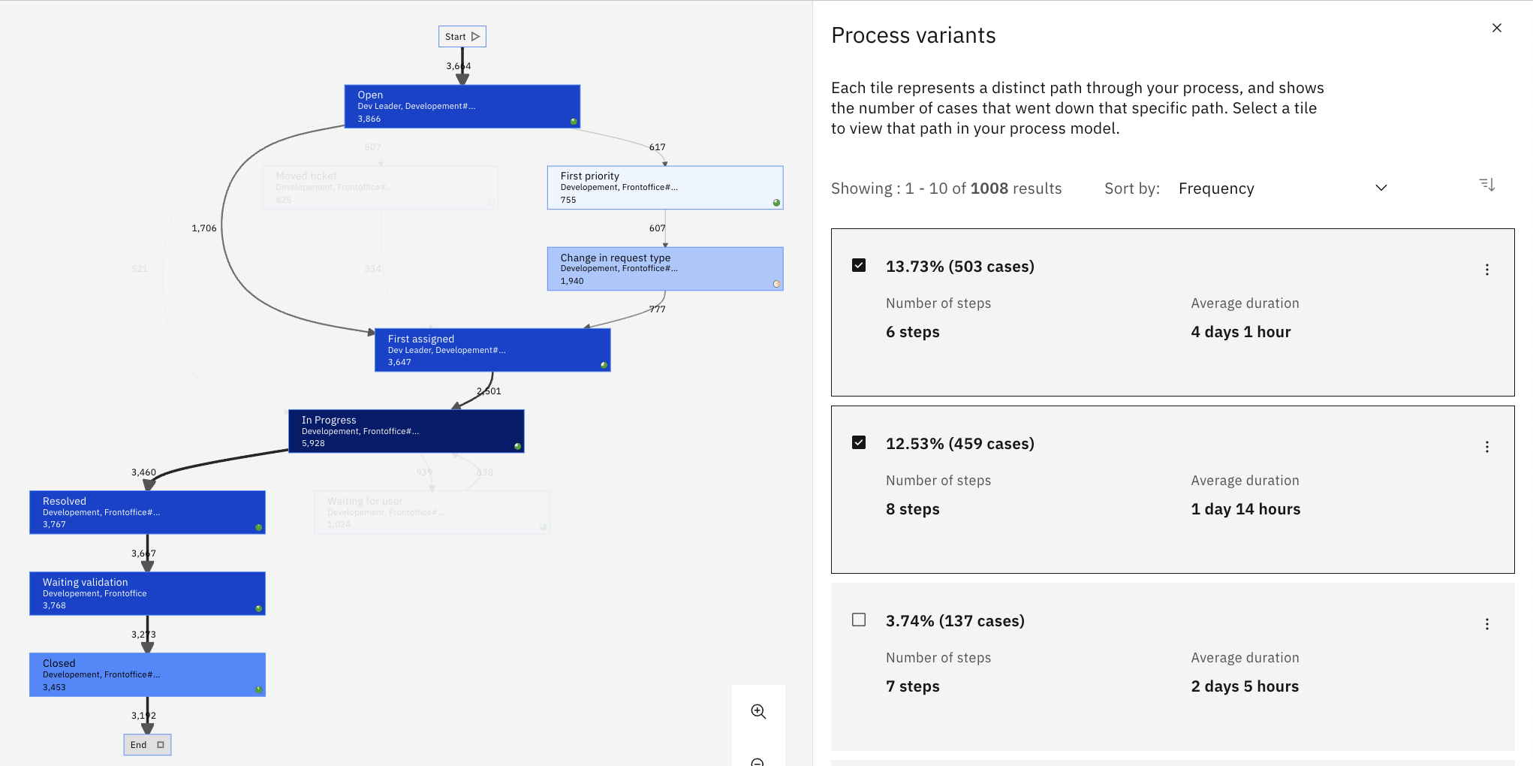
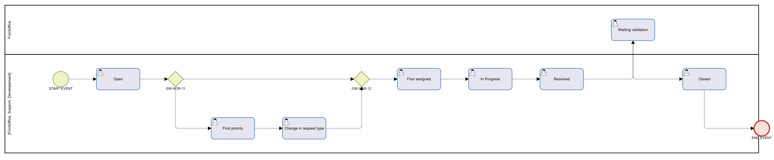
Process Discovery
Visualize o comportamento real do processo com base em dados
Atividades e transições mais frequentes
Duração de cada etapa do processo para identificar gargalos
Retrabalhos
Automação Existente
Custo de cada etapa do processo
Análise de variantes → todos os diferentes caminhos para completar o processo
Identifique os caminhos mais frequentes e mais eficientes
Gerar processo BPMN

Slide 9
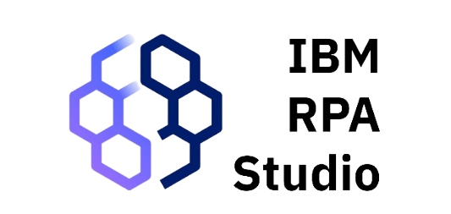

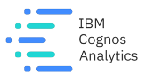
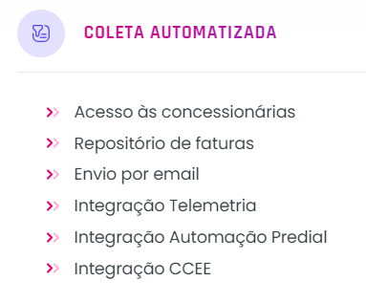
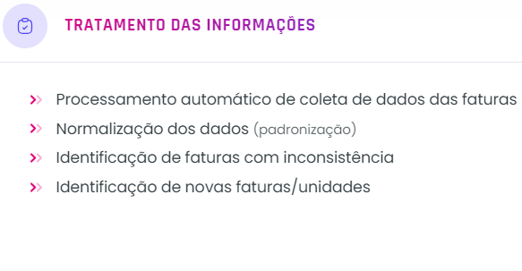
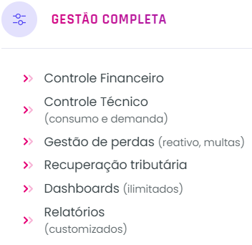
Desenho da Solução
Enel.
Copel.
IBM Cloud
Cemig.
IBM DPE
Normalização dos dados
CPFL.
Extração de dados com IA.
Light.
Etc..

Slide 10
CX-Energy

Slide 11
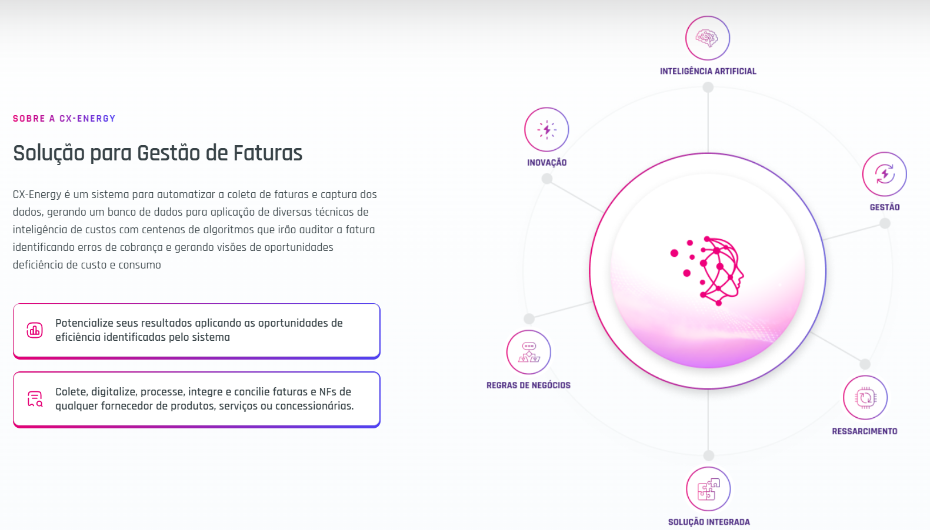

Slide 12
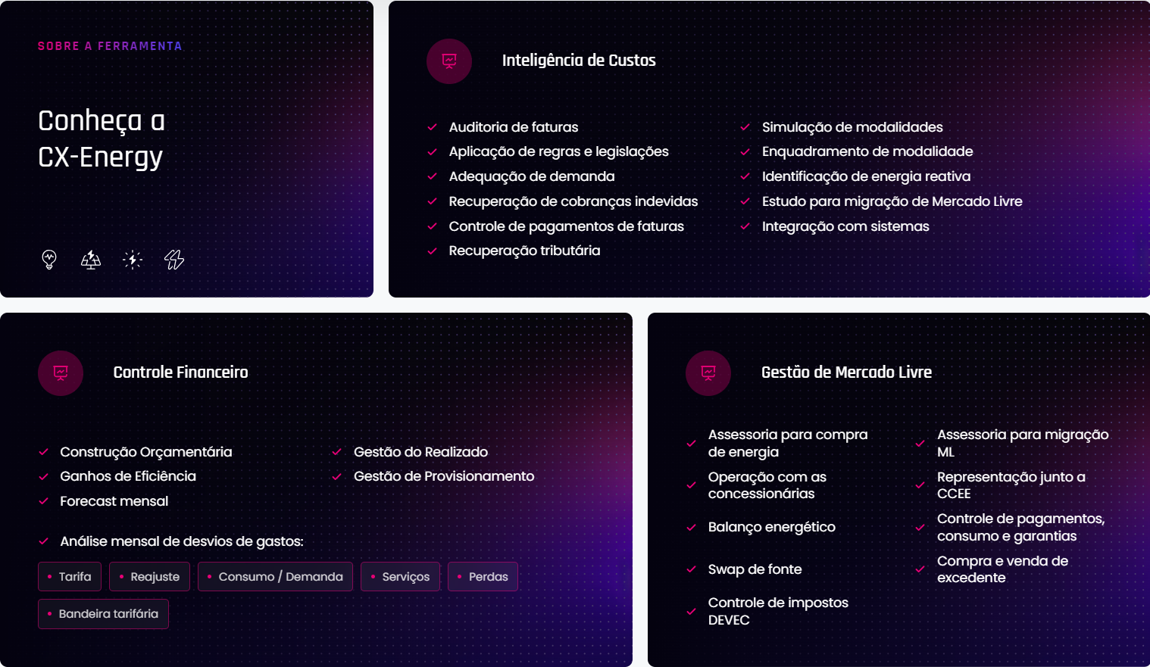

Slide 13
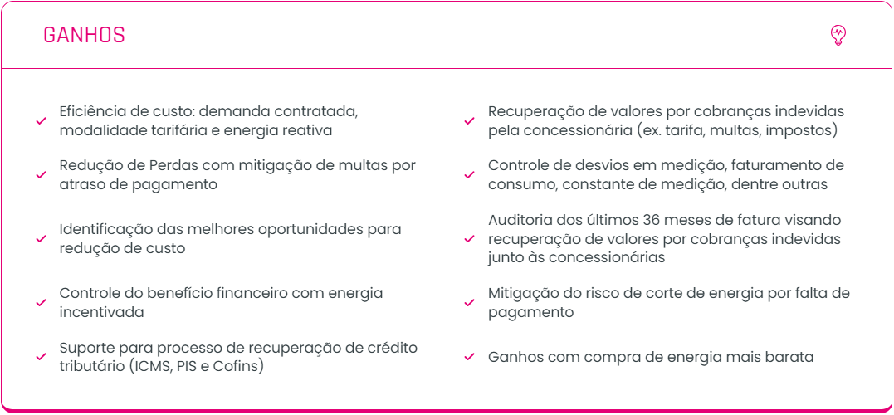

Slide 14
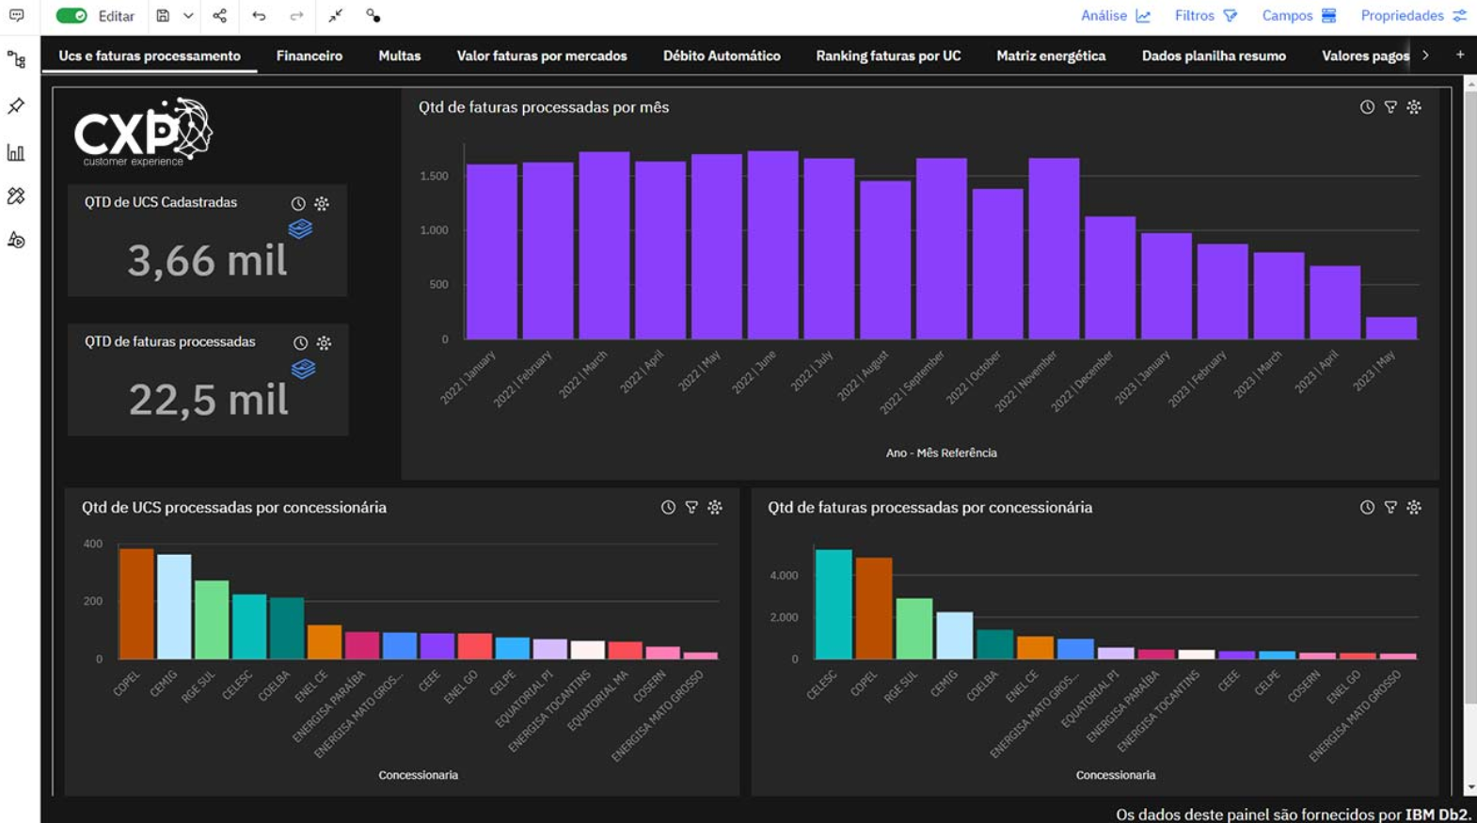
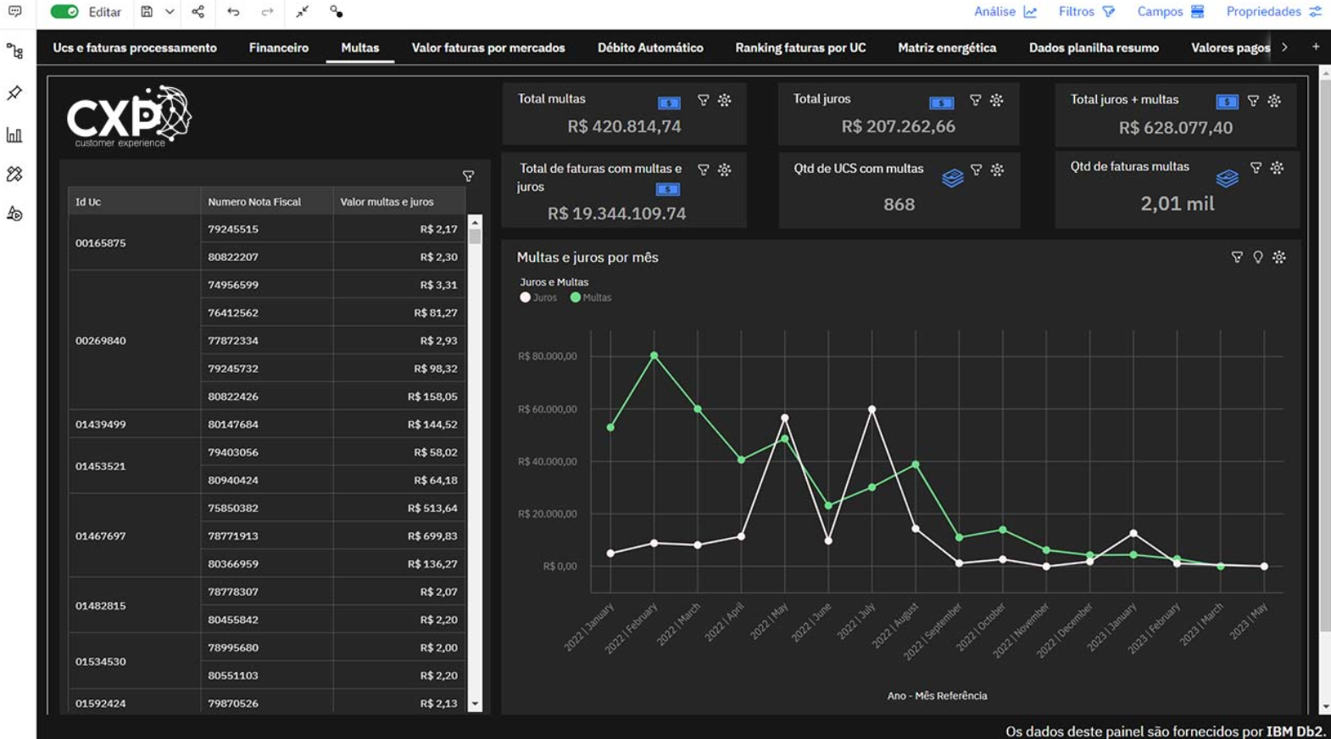
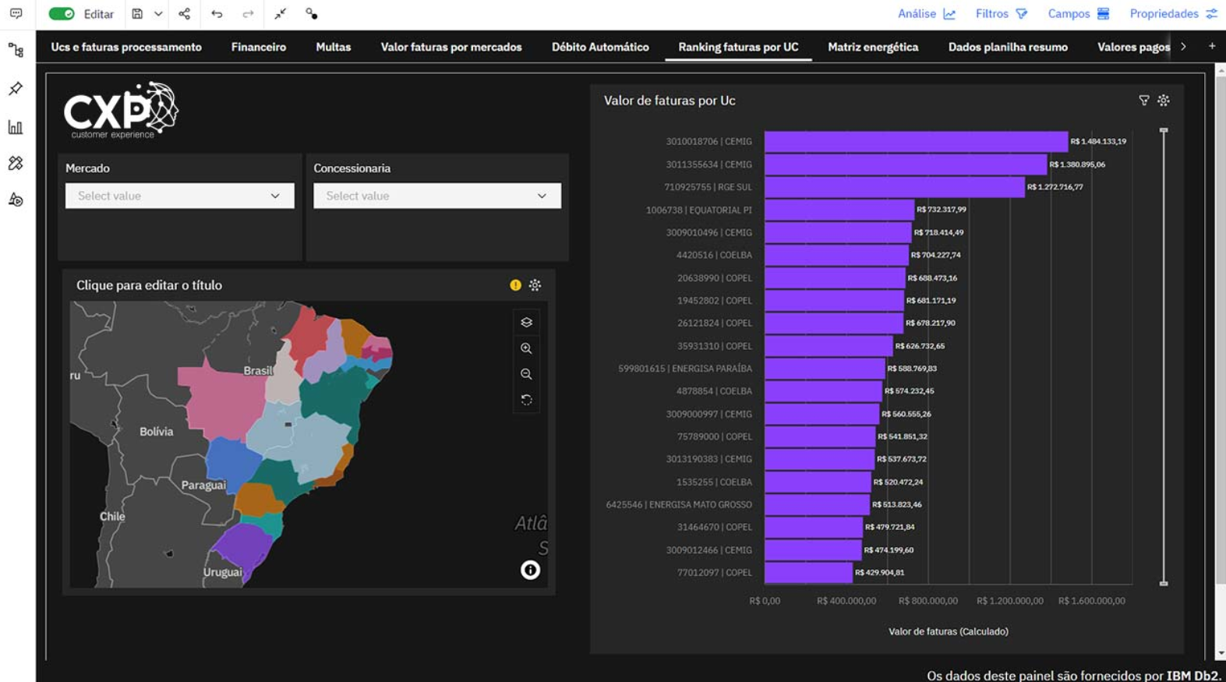
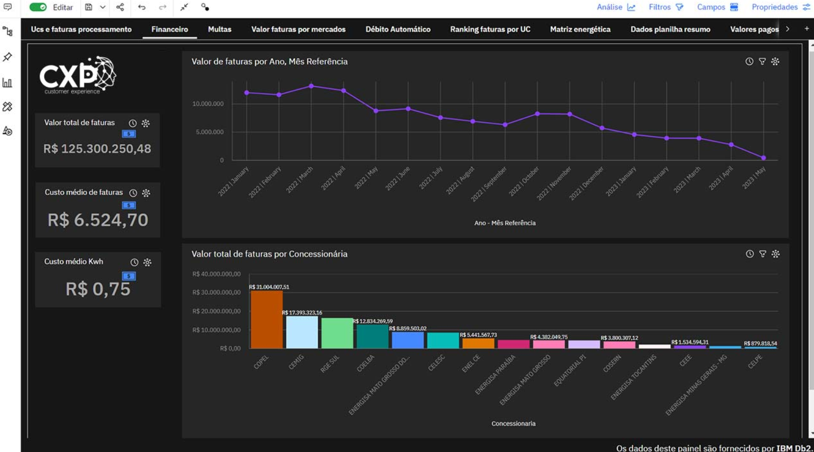
Resultado Final

Slide 15





odirley.silva@cxpbrasil.com.br
(11) 96173-1261
www.cxpbrasil.com.br
CXP Brasil Consulting
Notes:
The pitfall? Seventy percent of digital transformation projects fail. One of the reasons why they fail is because of a lack of integration quality, where the integration between the applications and systems don’t deliver the right data in the right time to the right place. With the urgency of trying to change and digitize all business, IBM believes it is more important than ever to ensure these transformations are guided by real world operational data that is meaningful to a client’s business, rather than relying on abstract models that attempt to represent on the business’ data. If clients use the wrong data in the wrong way, they will get to the wrong place faster.
What makes an integration project successful? Focus on ensuring the business is doing the right thing at the heart of the IT transformation – and that is the client’s integration. Identifying where the right point in a process integrations should take place is critical to success, and more importantly, how it impacts the business.
Businesses should ask themselves if they can make changes based on their operational data in a continuous feedback loop, allowing them to tune a business outcome based on their own actions and activity, and data. Bringing the ability for that integration to quickly adapt, automatically, as the business evolves. For example, IBM has mapping tools that get smarter and learn from each users’ individual mapping selections to help make future suggestions better.
The Integration Platform As A Service¹ (iPaaS) vendors, who host and manage platforms off premises, talk about automation. However, they are solely focused on speed, and that approach helps most businesses get to the wrong destination faster because this strategy doesn’t consider a closed loop² approach. It doesn’t consider how to use operational data and only thinks about a single style of integration. Business speed and adaptability should be the outcome, the result of the integration, not the pace at which the client first integrates.
[PROMPTING QUESTION]: Is the client seeing success in their digital transformation projects, and why or why not?
[Suggested follow up discussion points might include whether they can replicate success, and why they think they achieved it – and whether they can learn from failures – in much the same way as operational data in a feedback loop in the script]
[PROMPTING QUESTION]: Does the client’s integration approach utilize their company’s own operational data to help improve their integrations?
[Suggested follow up: This operational data feedback will lead to the ‘closed loop’ aspect of IBM’s integration automation which will be discussed further in upcoming charts.]
Notes:
¹ What is iPaaS? Generally, iPaaS refers to any cloud hosted or managed integration platform which a business would connect to for integrations to be ‘actioned’ rather than needing to install, configure and manage their own integration platform. More specifically it might be a simpler Integration platform, designed for more straightforward or business-led integrations (i.e. exchanging data between 2 popular applications or services, rather than solving complex legacy application integration issues)
² Closed loop is the practice of feeding a company’s operational data back into a process that can be used to inform the intelligence that is automating integration work. One example is real-world execution of a business' APIs which can be fed back into the test suite for future API testing. Another example, power users own mapping selections are used to adjust the smart mapping model to suggest more likely mappings and transformations.
Sources: Forbes , McKinsey , CMSWire , Gartner Top 10 Trends in PaaS and Platform Innovation, 2020

